Slide 1


Machine Learning and Medical Engineering Applications 机器学习与医学工程应用
Lecture 5 - Ridge and LASSO for modelling the brain
Quanying Liu （刘泉影）
SUSTech, BME department
Email: liuqy@sustech.edu.cn
BME215001, Spring term, 2024

Slide 2
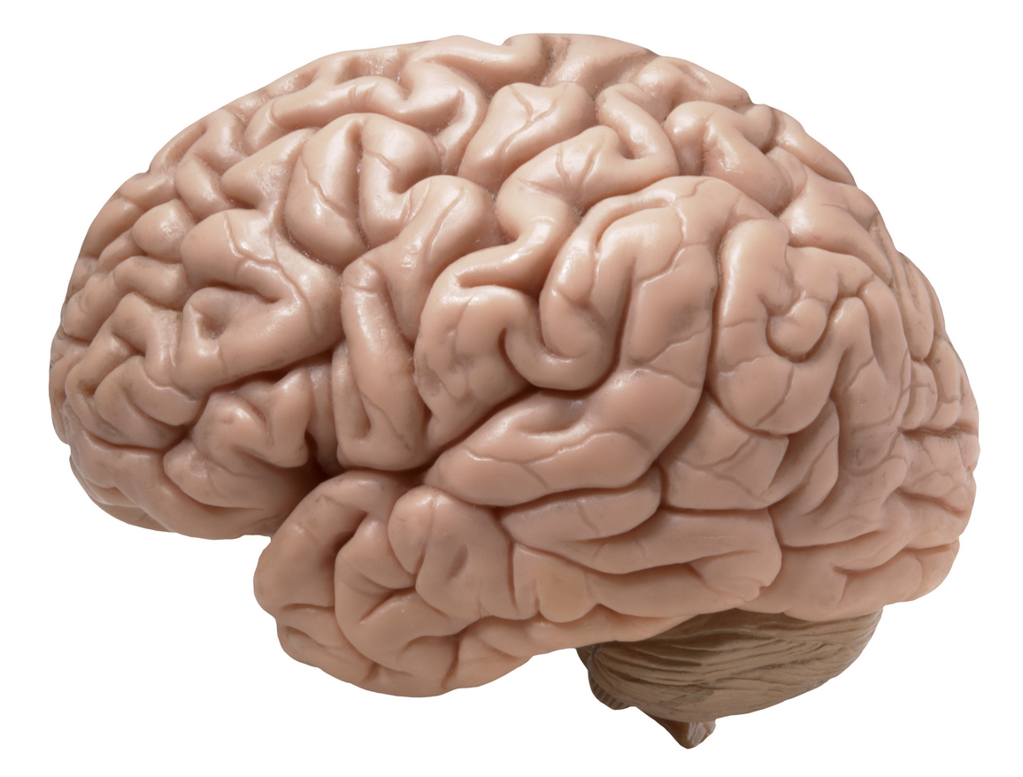
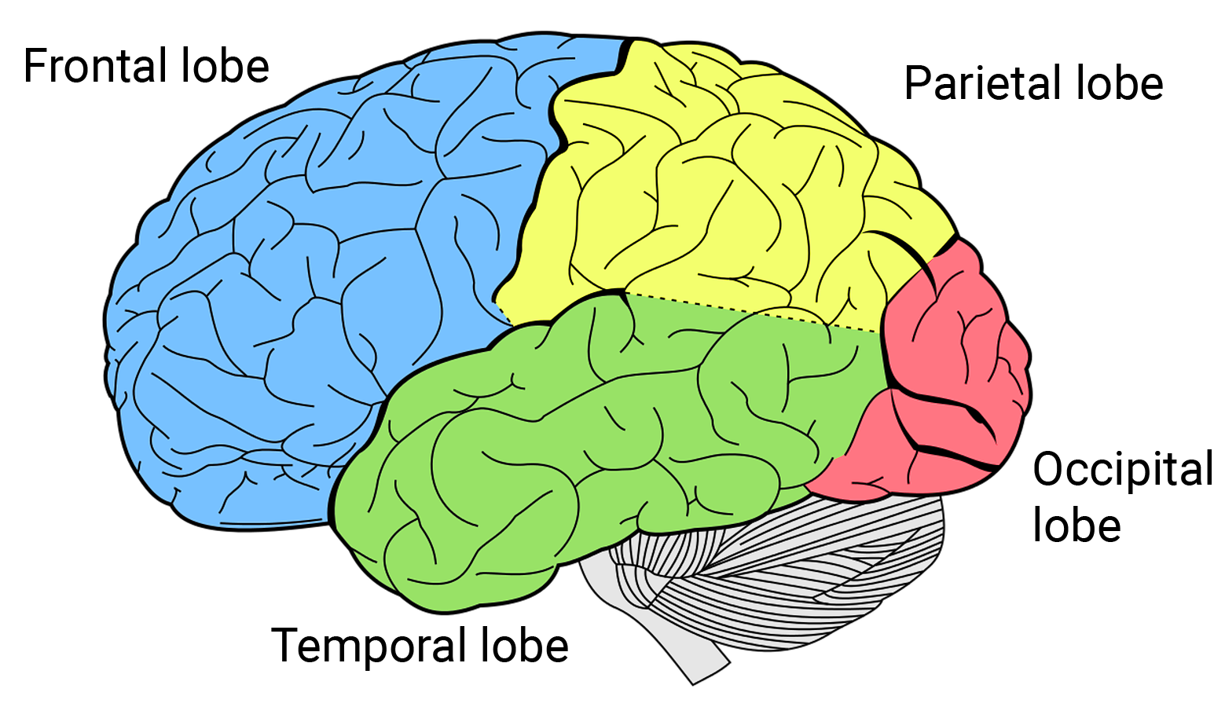


The human brain
hundreds of
regions
100 billions of neurons
a brain
few lobes
The neurons (regions) are connected by synapses (white matter fibers).
The activity of the connected neurons (regions) are coupled.
Notes:
Consider our human being as a dynamic system and brain as a controller.

Slide 3
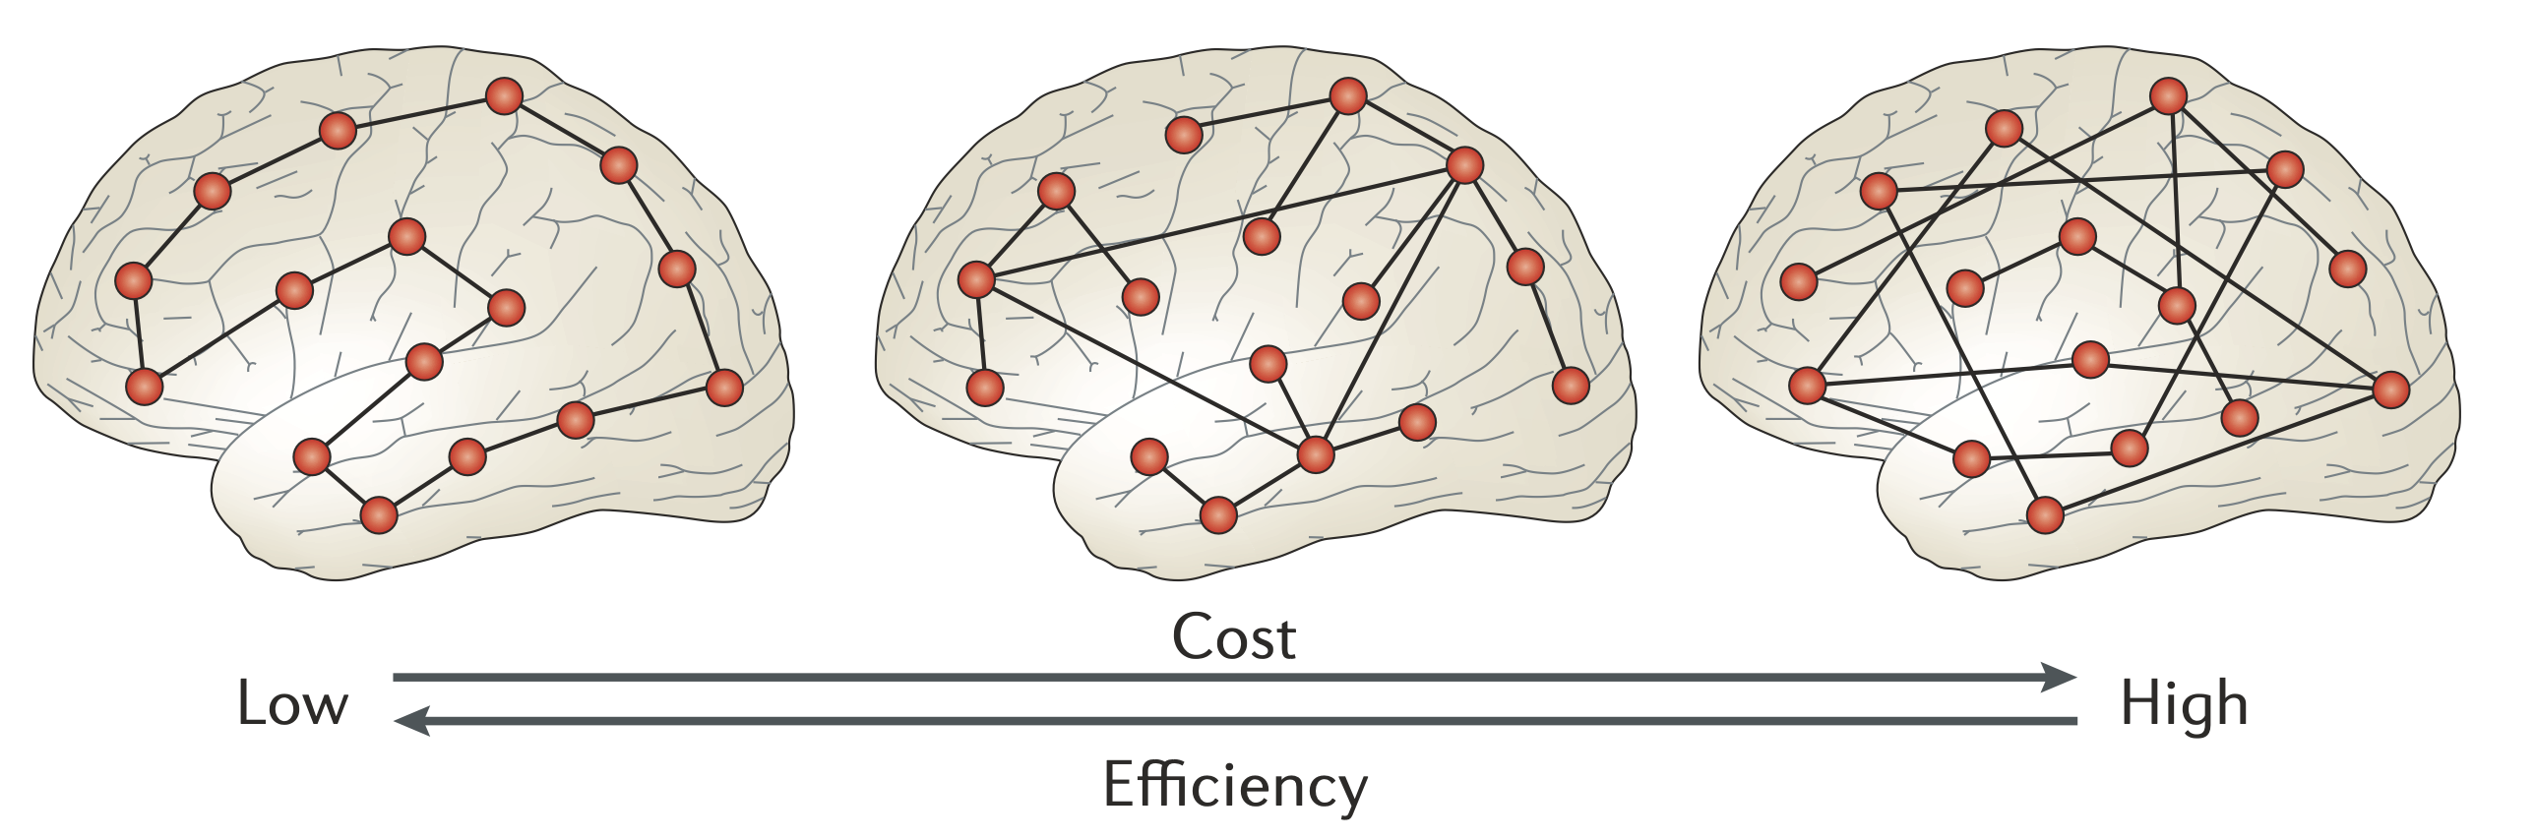
The economy of brain network organization
Efficiency and economy tradeoff in brain
The brain can increase connection strength to increase communication efficiency, but it compromises the economy as wiring cost increases.
How the brain evolves to its topography remains unknown.
Bullmore et al., 2012

Slide 4
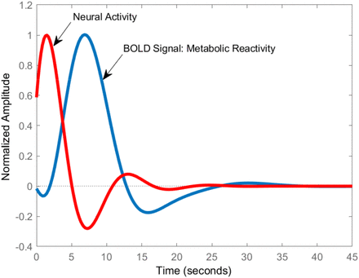
Linear system of the large-scale fMRI dynamics
Macroscopic resting-state fMRI (rsfMRI)
Blood-oxygen-level-dependent (BOLD) in fMRI is a method measuring brain activity by detecting changes in blood oxygenation and flow.
Hemodynamic Response Function (HRF) is a model of the blood flow changes in the brain following neural activity.

Slide 5
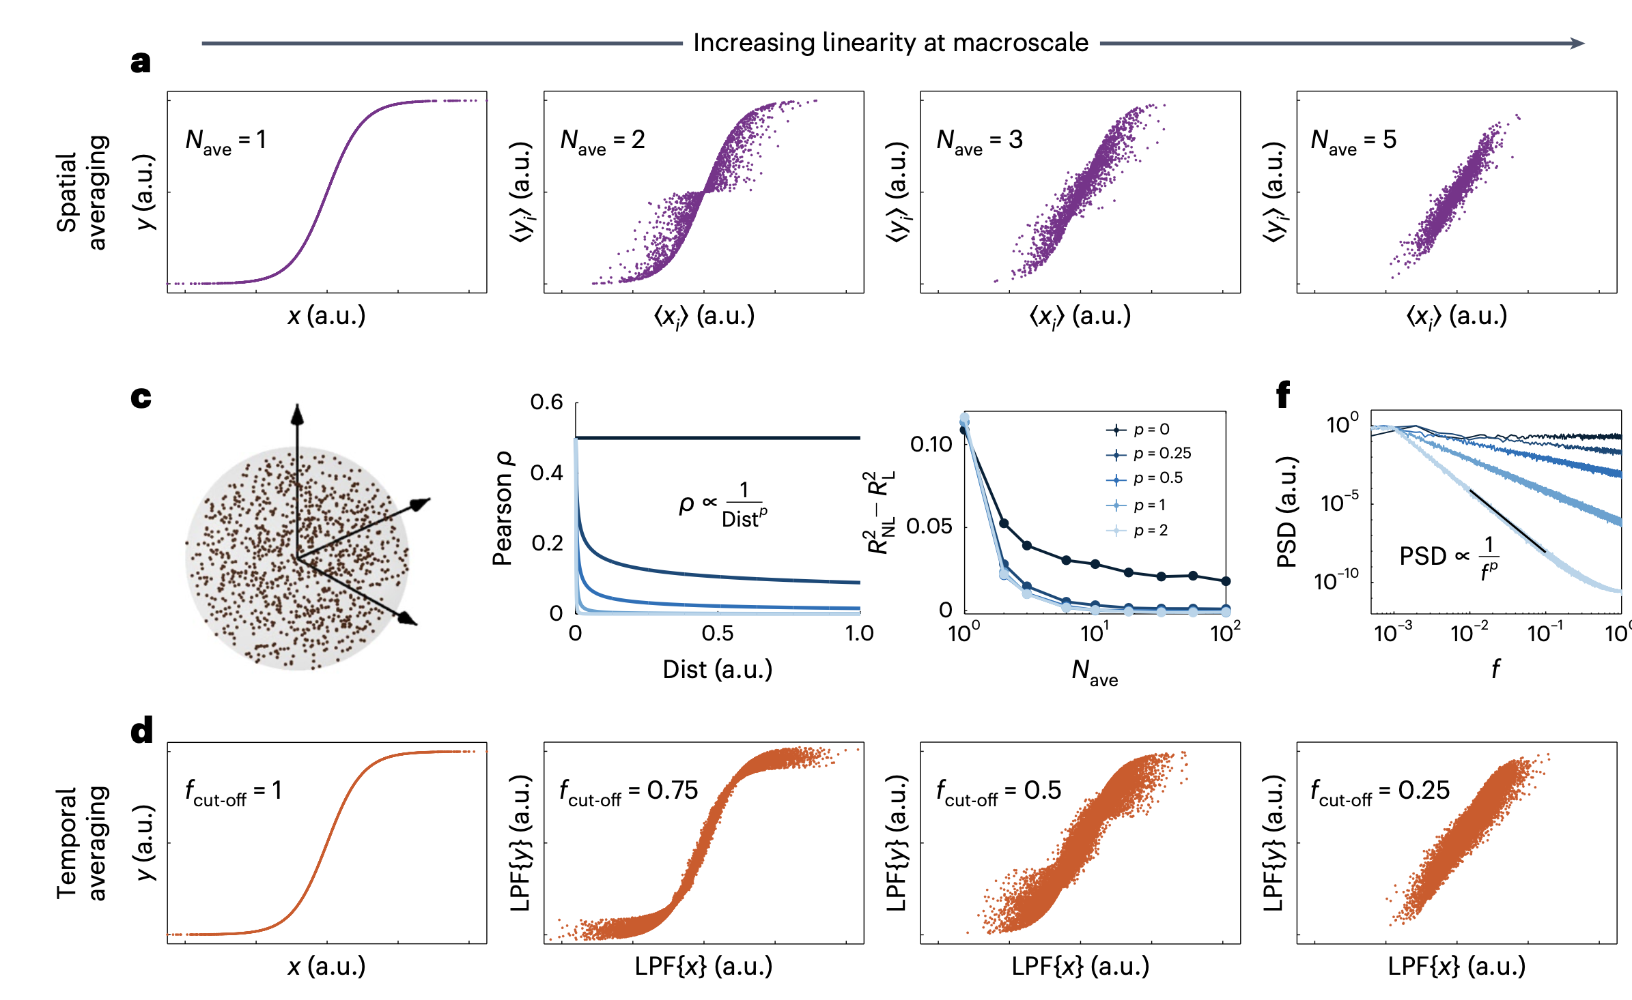
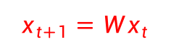
Linear system of the large-scale fMRI dynamics
Macroscopic resting state fMRI (rsfMRI)
In large scale fMRI paradigm, single neuron’s non-linear activity is averaged spatially and temporally.
Macroscopic rsfMRI shows linear effect, which can be described by linear models.
$$x_{t+1}=Wx_{t}$$
Nozari et al.,
2023, Nature BME

Slide 6
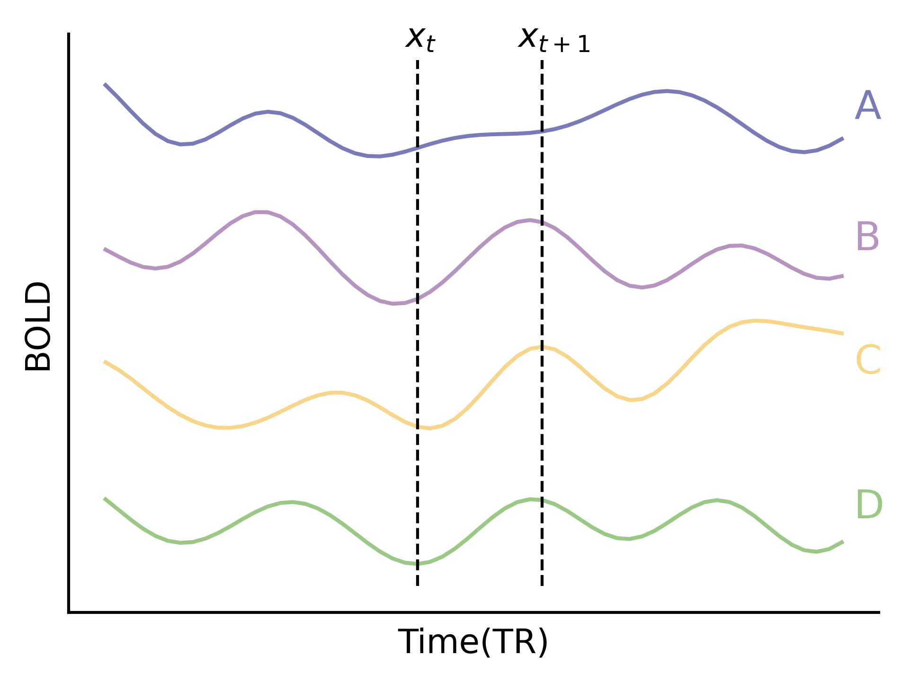
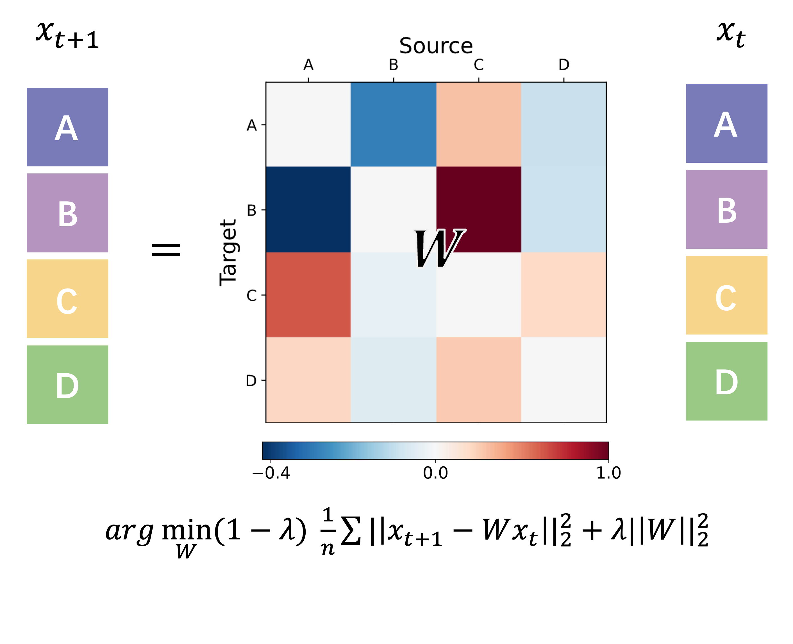
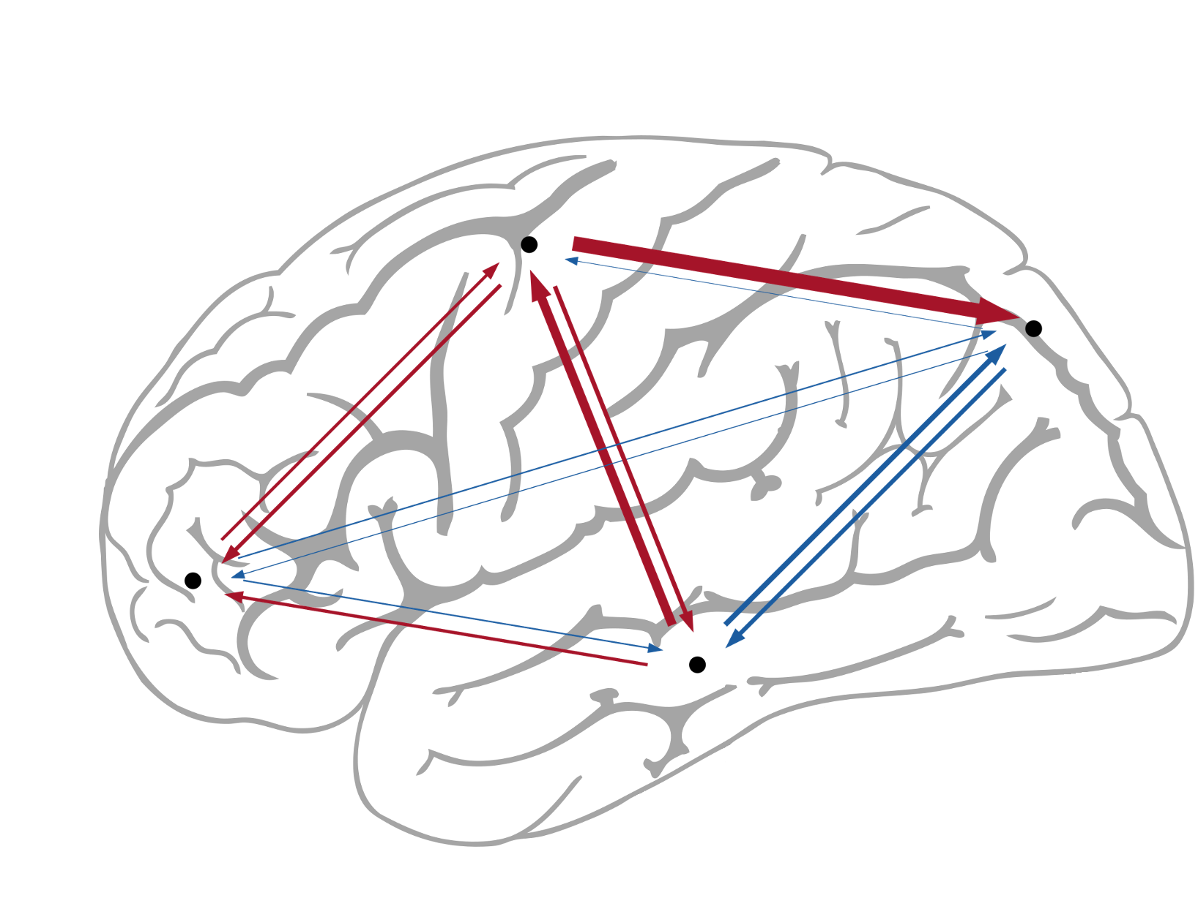
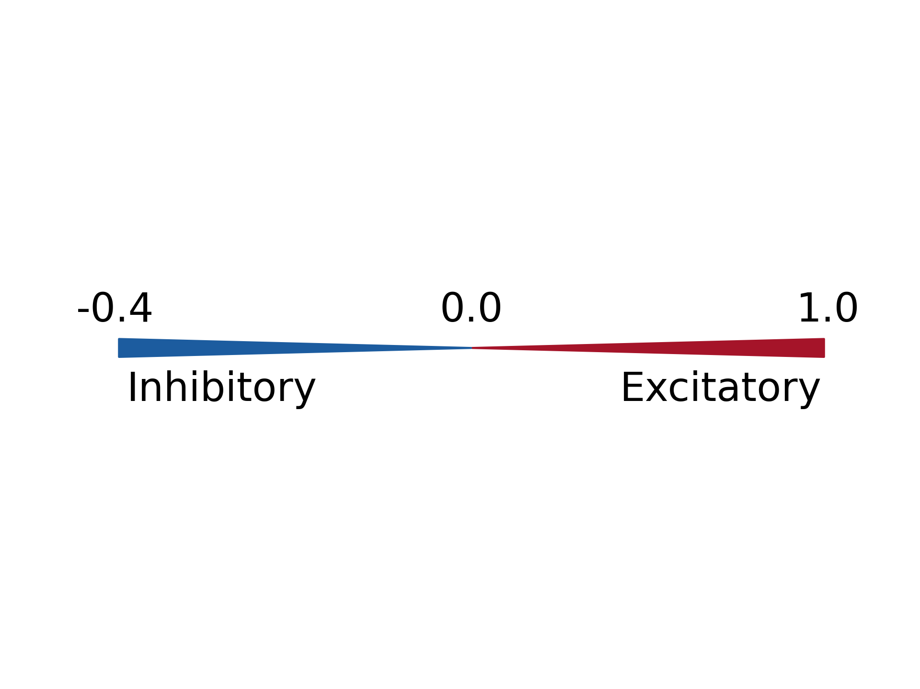
Modeling of the brain dynamics by linear model
fMRI ridge regression schematic diagram
Use activity levels in each region to predict the levels in other regions at next sampling point.
The W explicitly reveals the effective connectivity in brain.

Slide 7

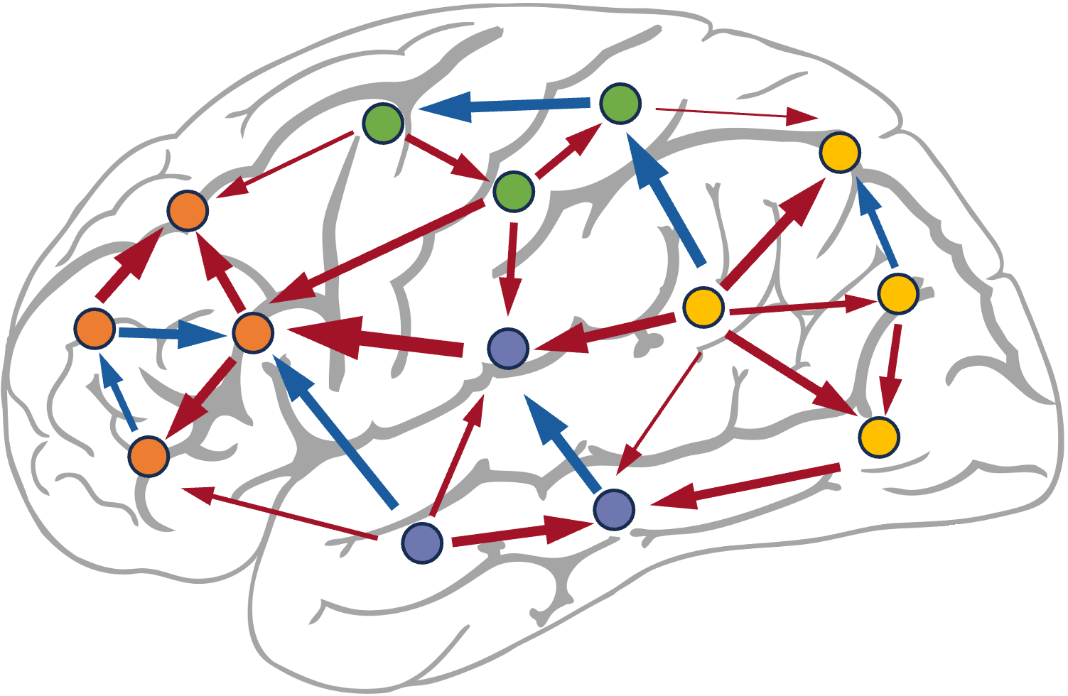
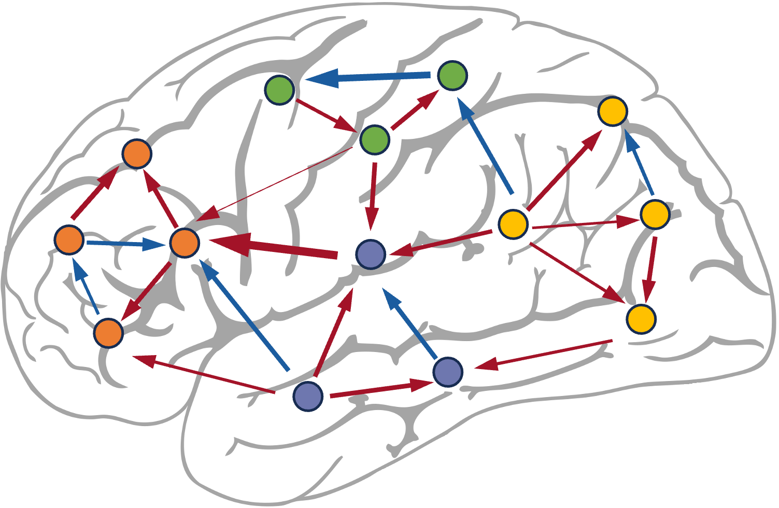
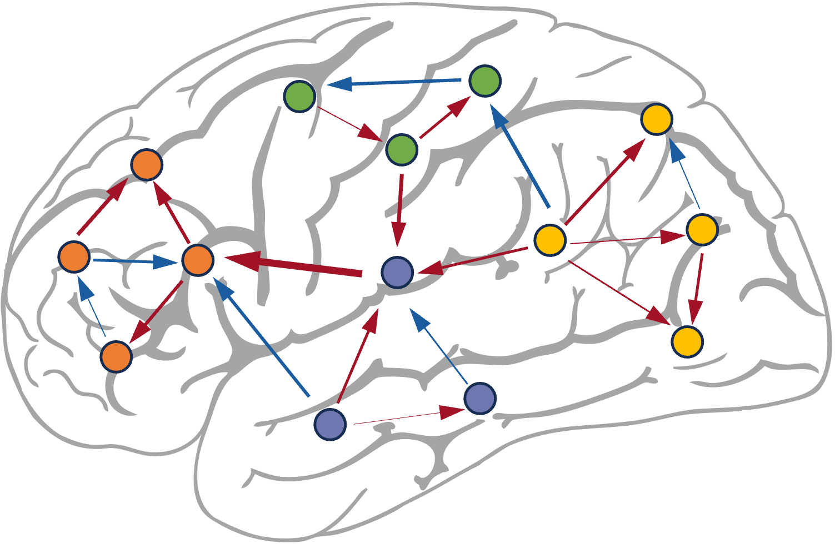
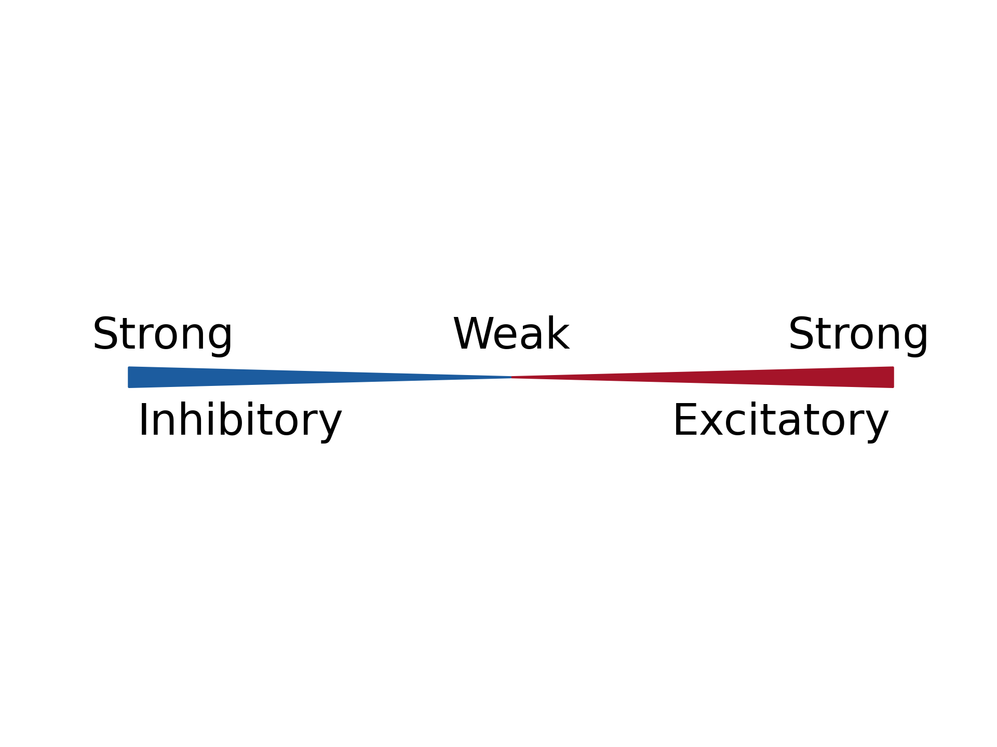
Modeling of the brain dynamics by linear model
卓著
Constrain the brain wiring by L2 regularization
Higher λ results in constrained connection, thus increasing the economy while decreasing the efficiency.
$arg\min_{W}{(1−λ) \frac{1}{n}\sum{{|\left|x_{t+1}−Wx_{t}\right||}_{2}^{2}}+λ{|\left|W\right||}_{2}^{2}}$
increasing λ

Slide 8
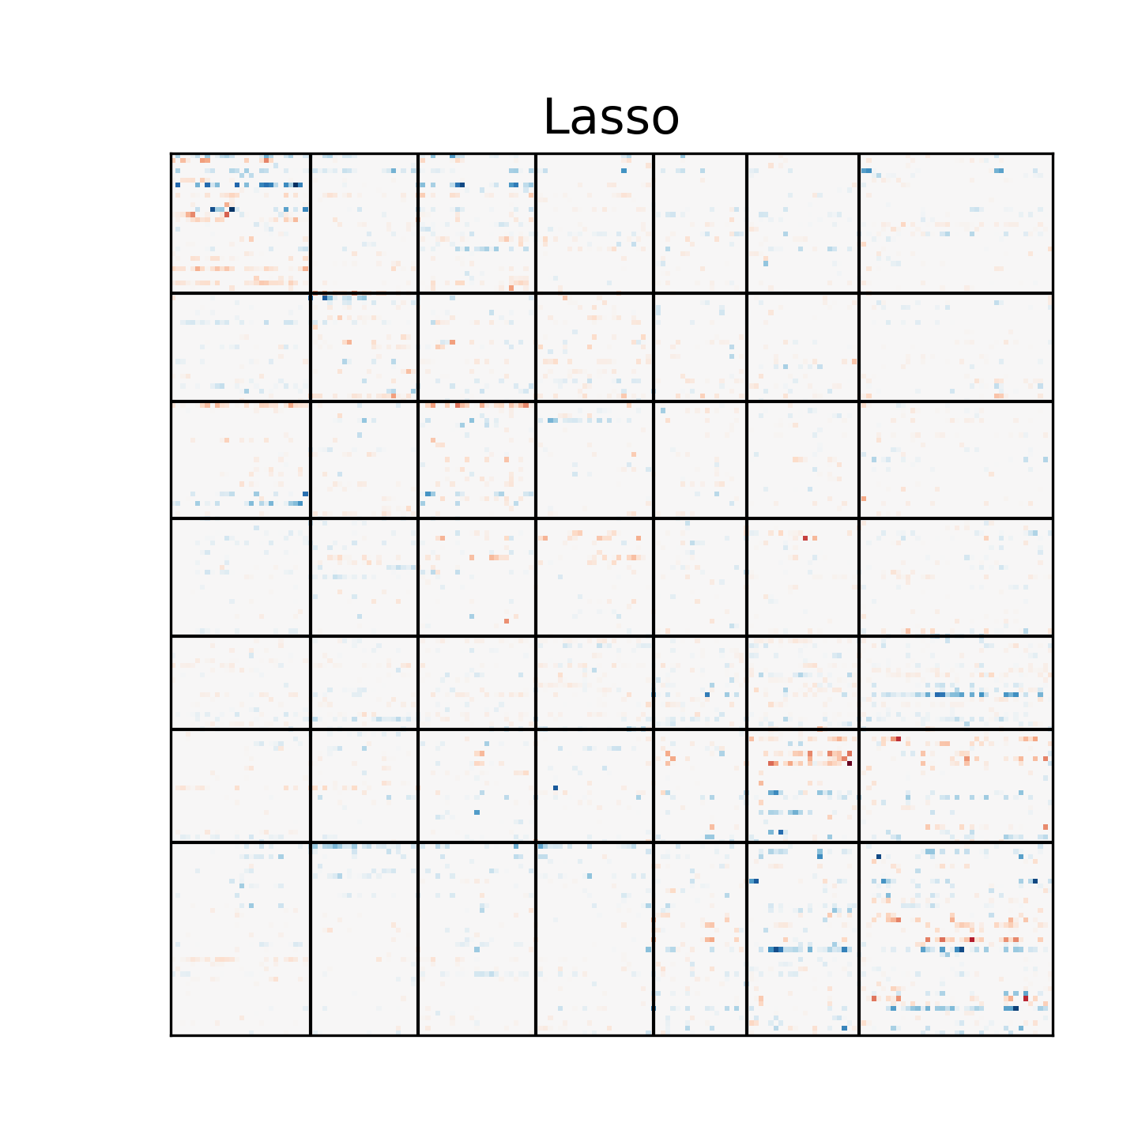
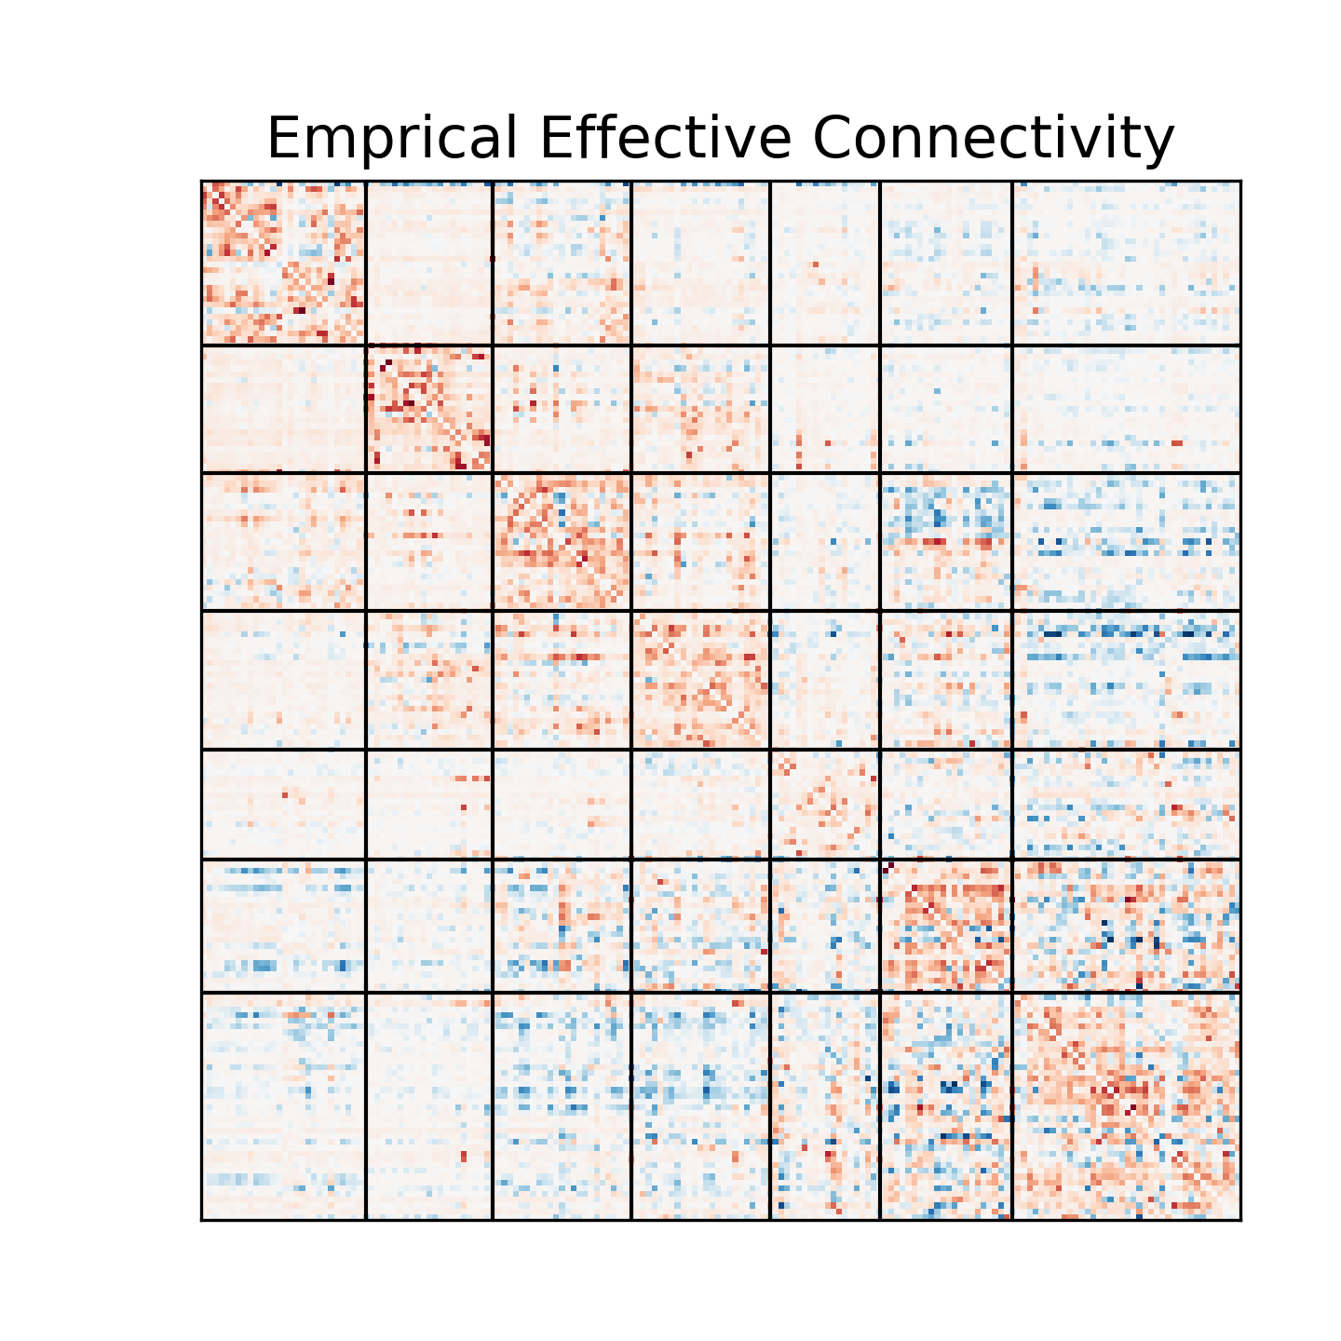
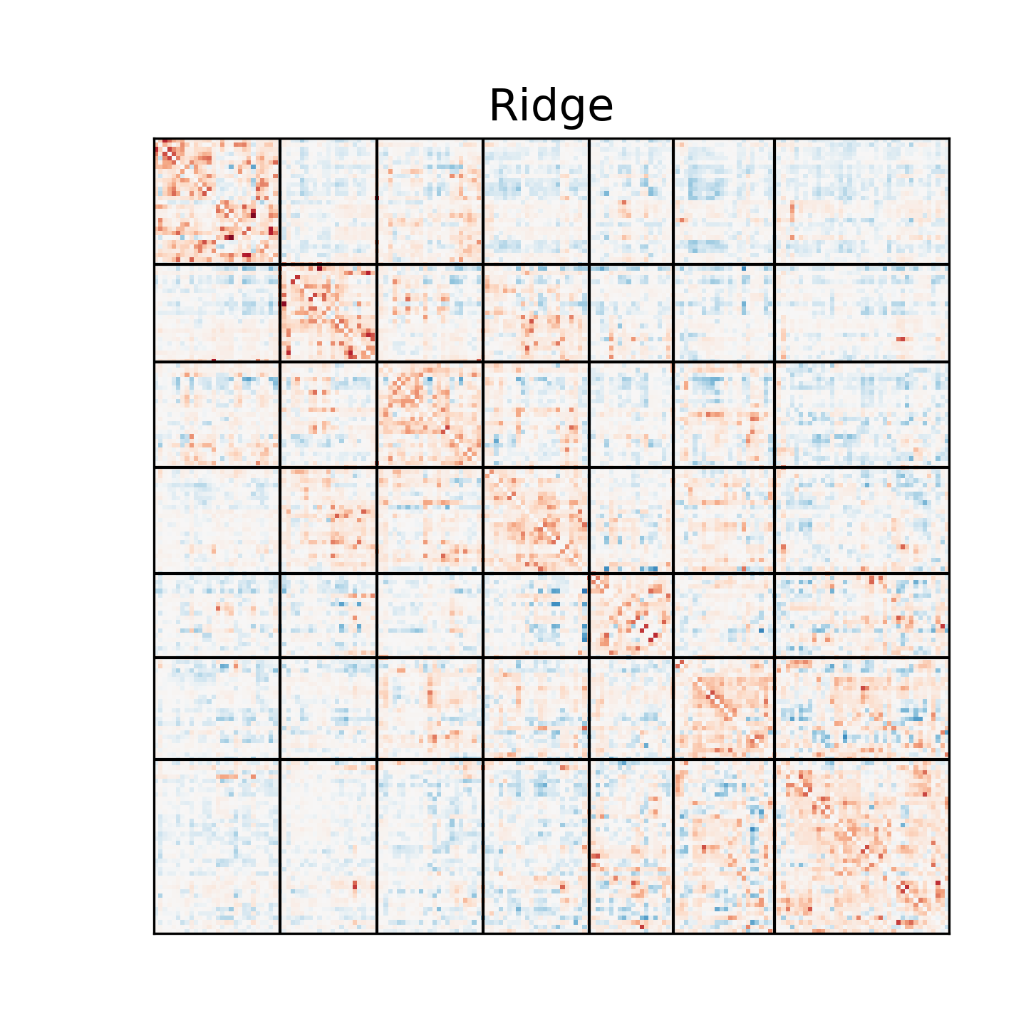
Comparison between Lasso and Ridge
$arg\min_{W}{(1−λ) \frac{1}{n}\sum{{|\left|x_{t+1}−Wx_{t}\right||}_{2}^{2}}+λ{|\left|W\right||}_{1}^{1}}$
$arg\min_{W}{(1−λ) \frac{1}{n}\sum{{|\left|x_{t+1}−Wx_{t}\right||}_{2}^{2}}+λ{|\left|W\right||}_{2}^{2}}$
Connectivity revealed by Ridge resembles empirical data more than that by Lasso.
According to the prior, it may indicate that the connections in brain are smooth rather than sparse.

Slide 9
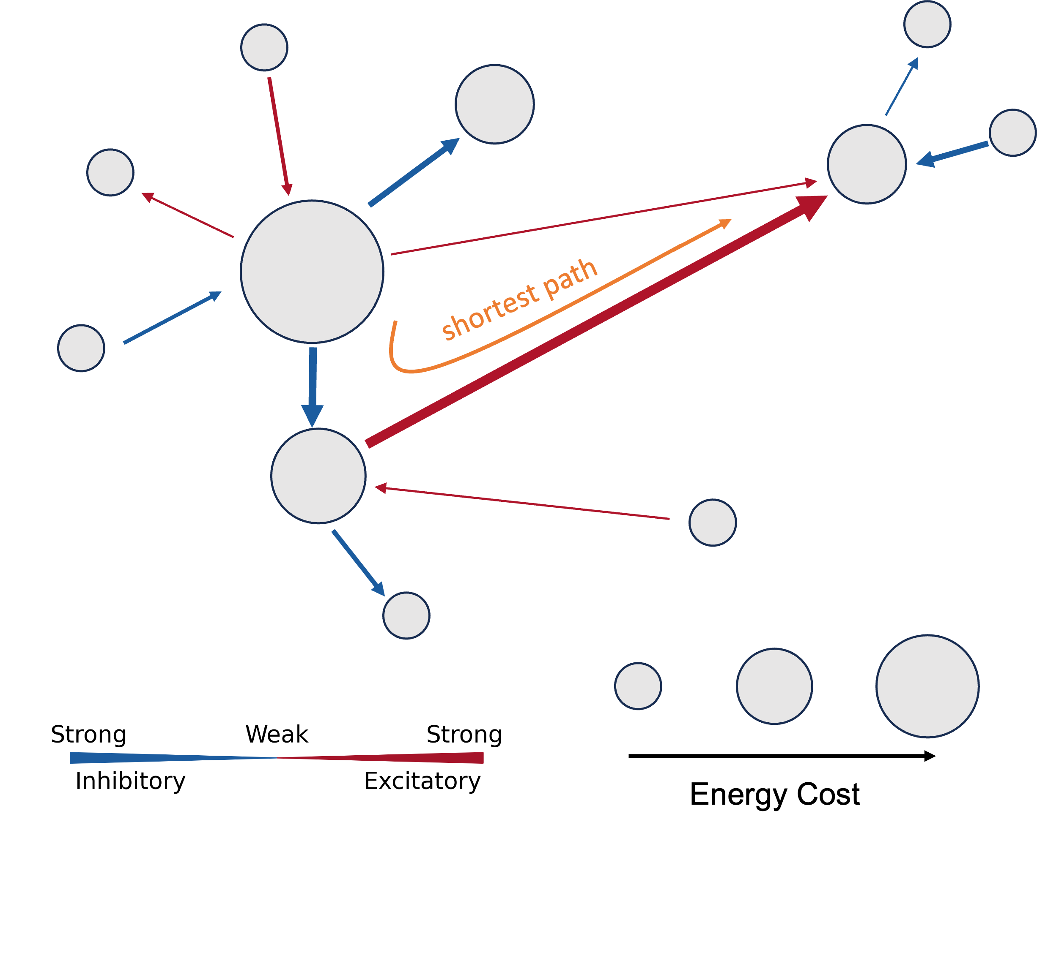
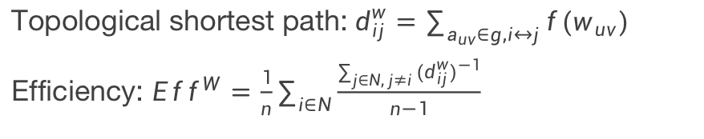
Quantify the Efficiency and Economy
Quantify the network efficiency
If the absolute connection strength between two nodes is high, it will be easier for them to do communication, thus they are shorter in topological space.
The efficiency is defined as the average shortest path from one node to another in the network.
Topological shortest path:$d_{ij}^{w}=\sum_{a_{uv}∈g,i↔j}{f(w_{uv})}$
Efficiency: ${Eff}^{W}=\frac{1}{n}\sum_{i∈N}{\frac{\sum_{j∈N, j≠i}{{(d_{ij}^{w})}^{−1}}}{n−1}}$

Slide 10
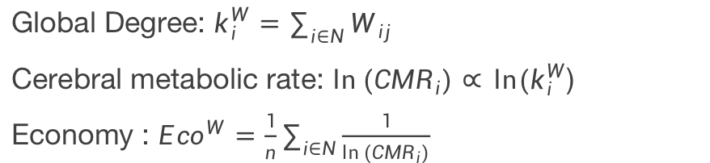
Quantify the Efficiency and Economy
Quantify the network economy
The metabolic rate is logarithmically proportional to the global degree of the node. (Tomasi et. al., 2013)
The economy is defined as average of each node’s reciprocal of global degree.
Global Degree: $k_{i}^{W}=\sum_{i∈N}{W_{ij}}$
Cerebral metabolic rate: $\ln{({CMR}_{i})∝} ln⁡(k_{i}^{W}$)
Economy : ${Eco}^{W}=\frac{1}{n}\sum_{i∈N}{\frac{1}{\ln{({CMR}_{i})}}}$

Slide 11
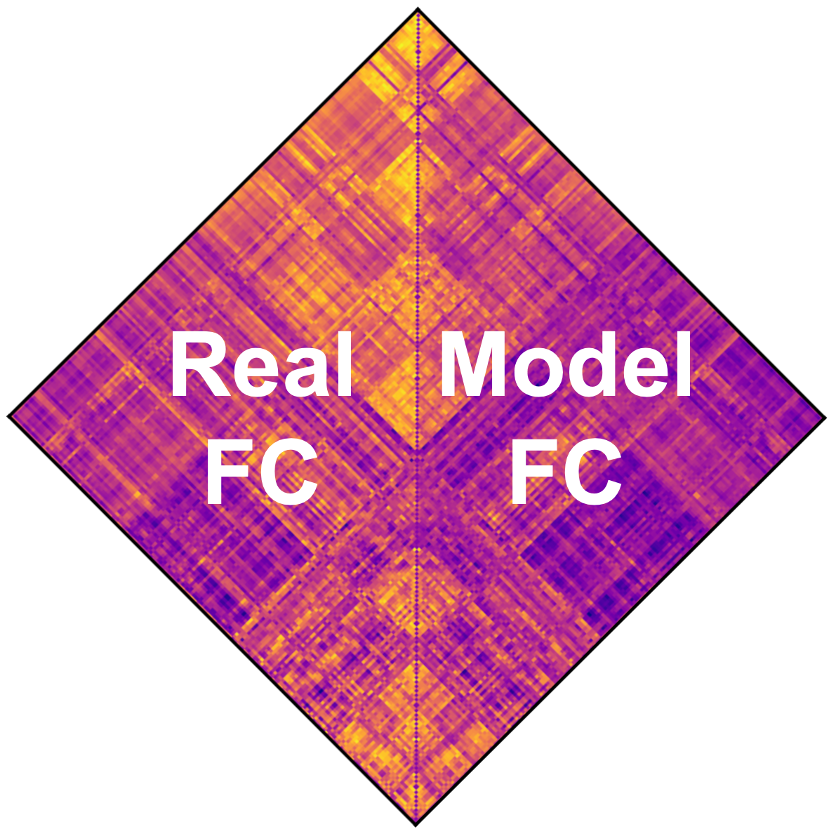
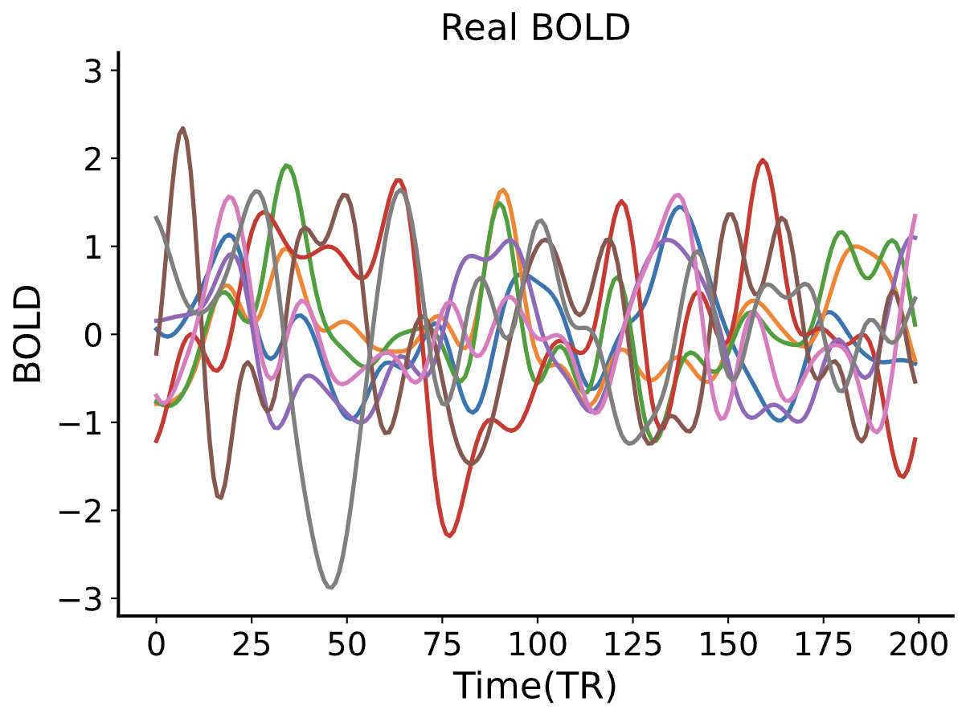
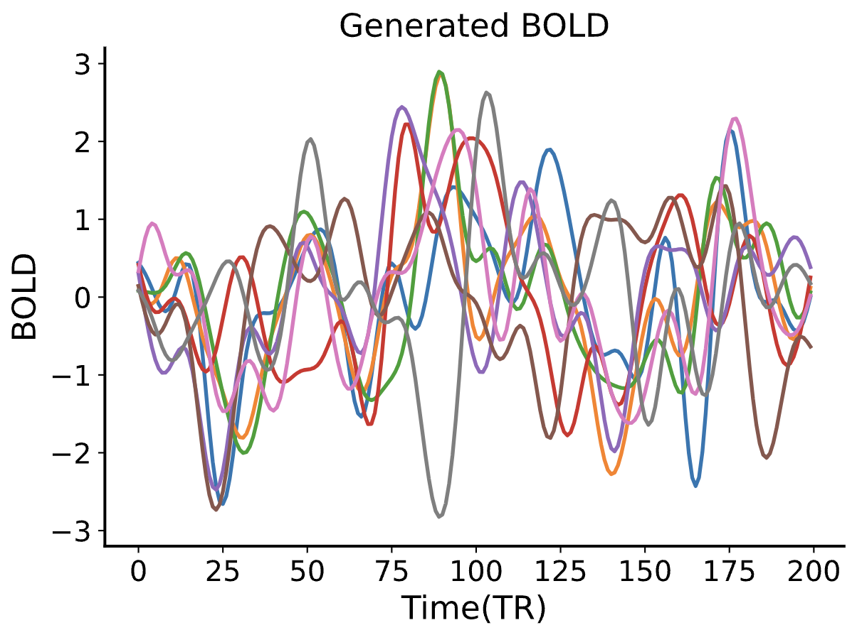
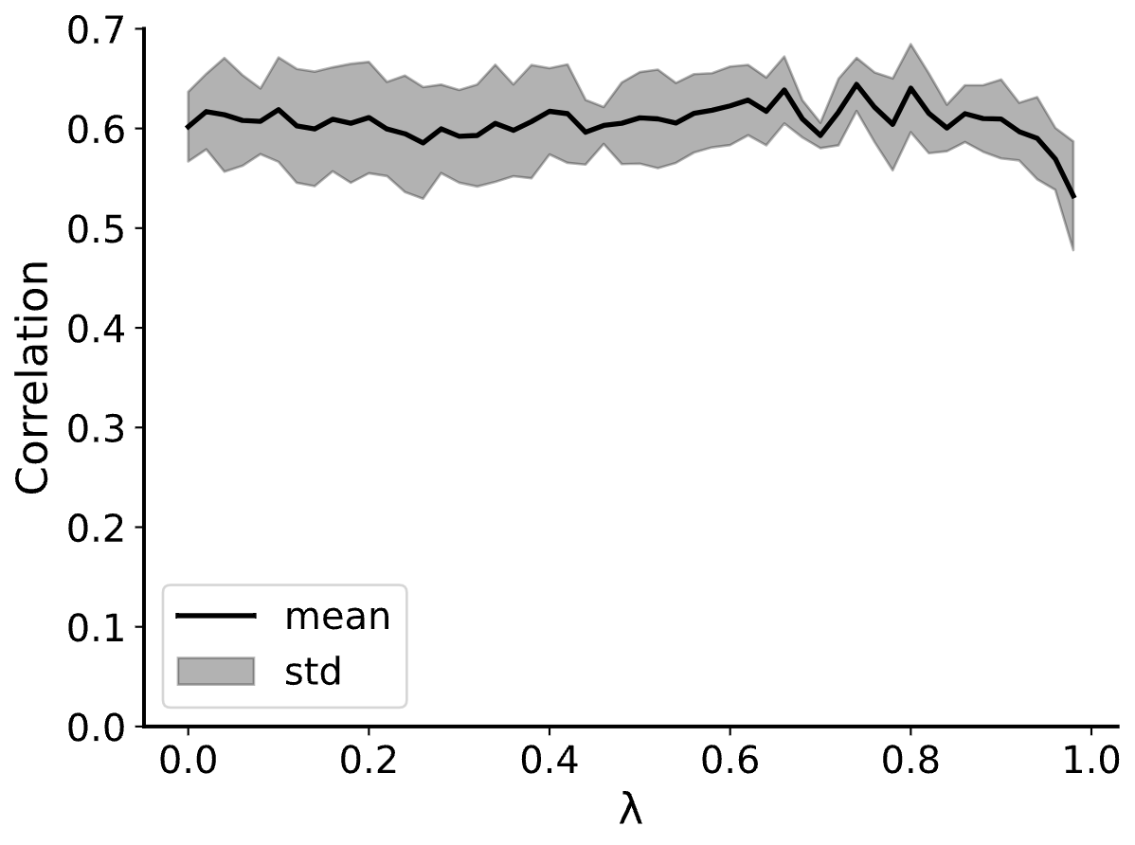
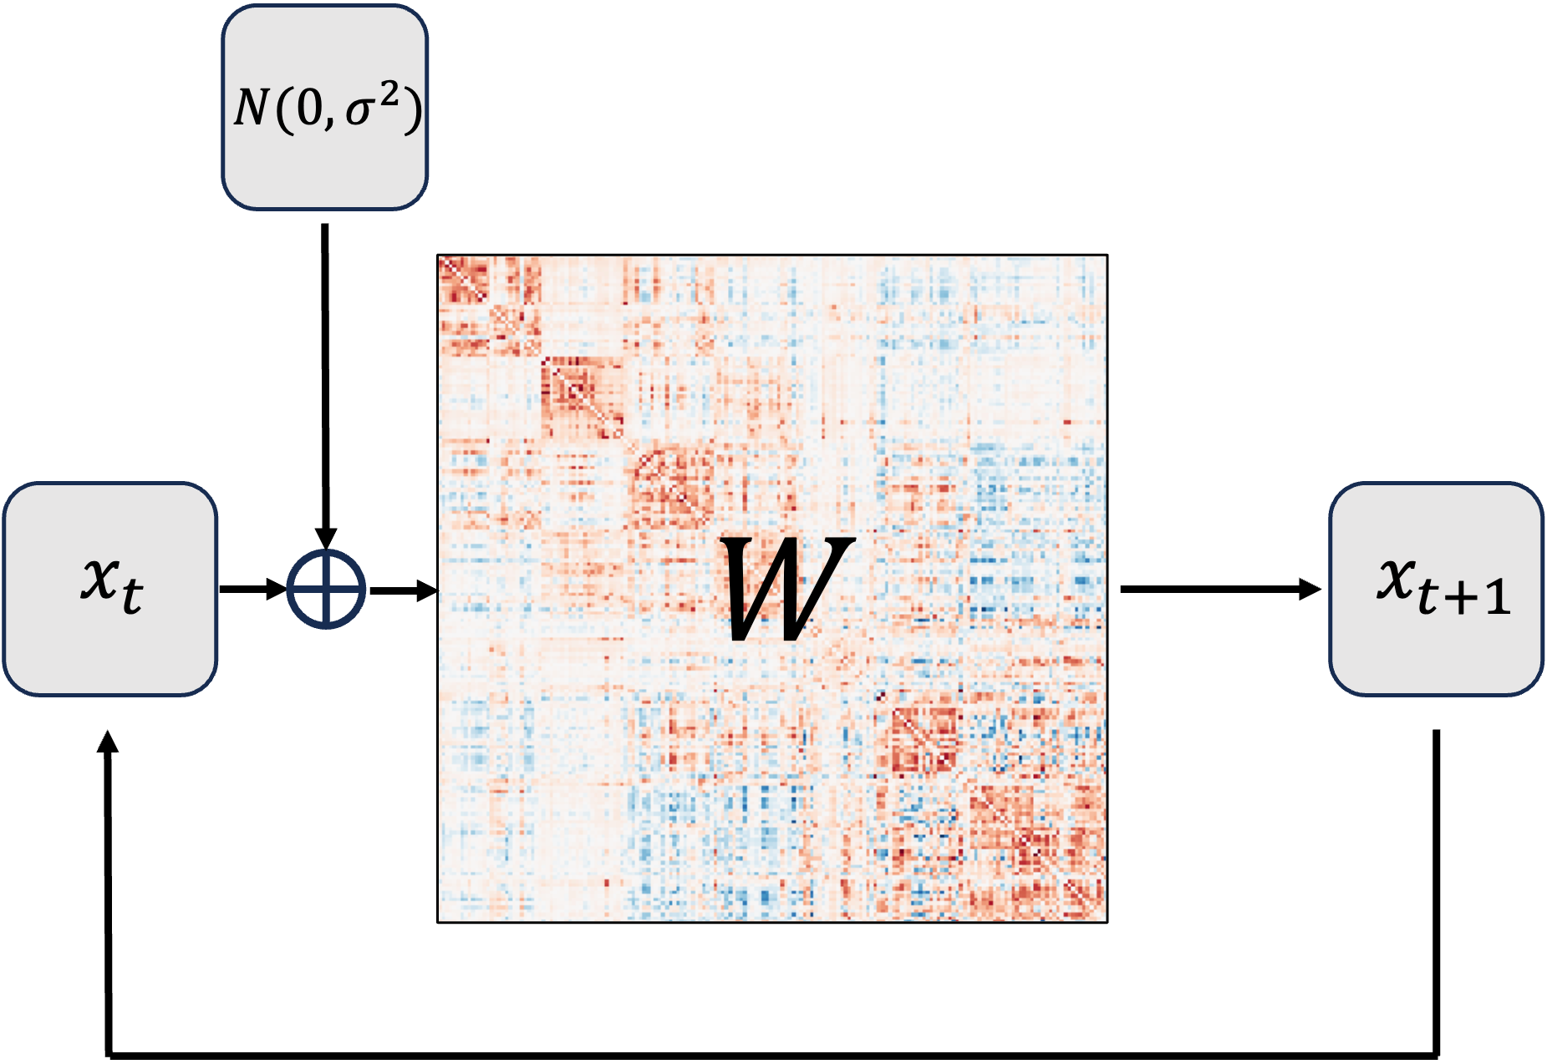
EC Ridge Model Validation
BOLD generator
Correlation (Real FC, Model FC)

Slide 12
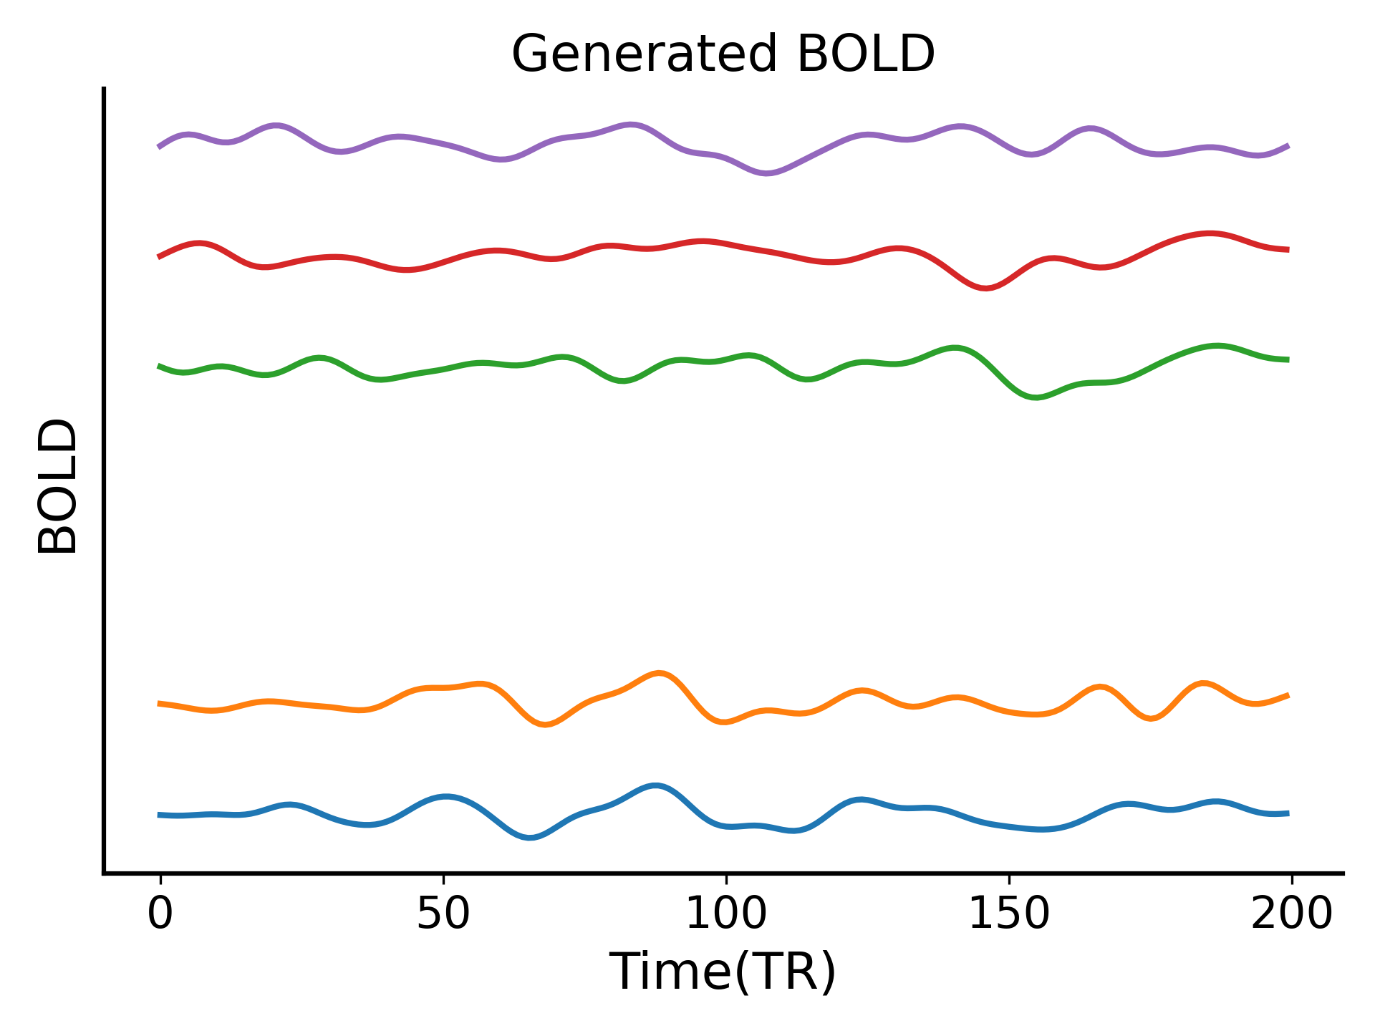
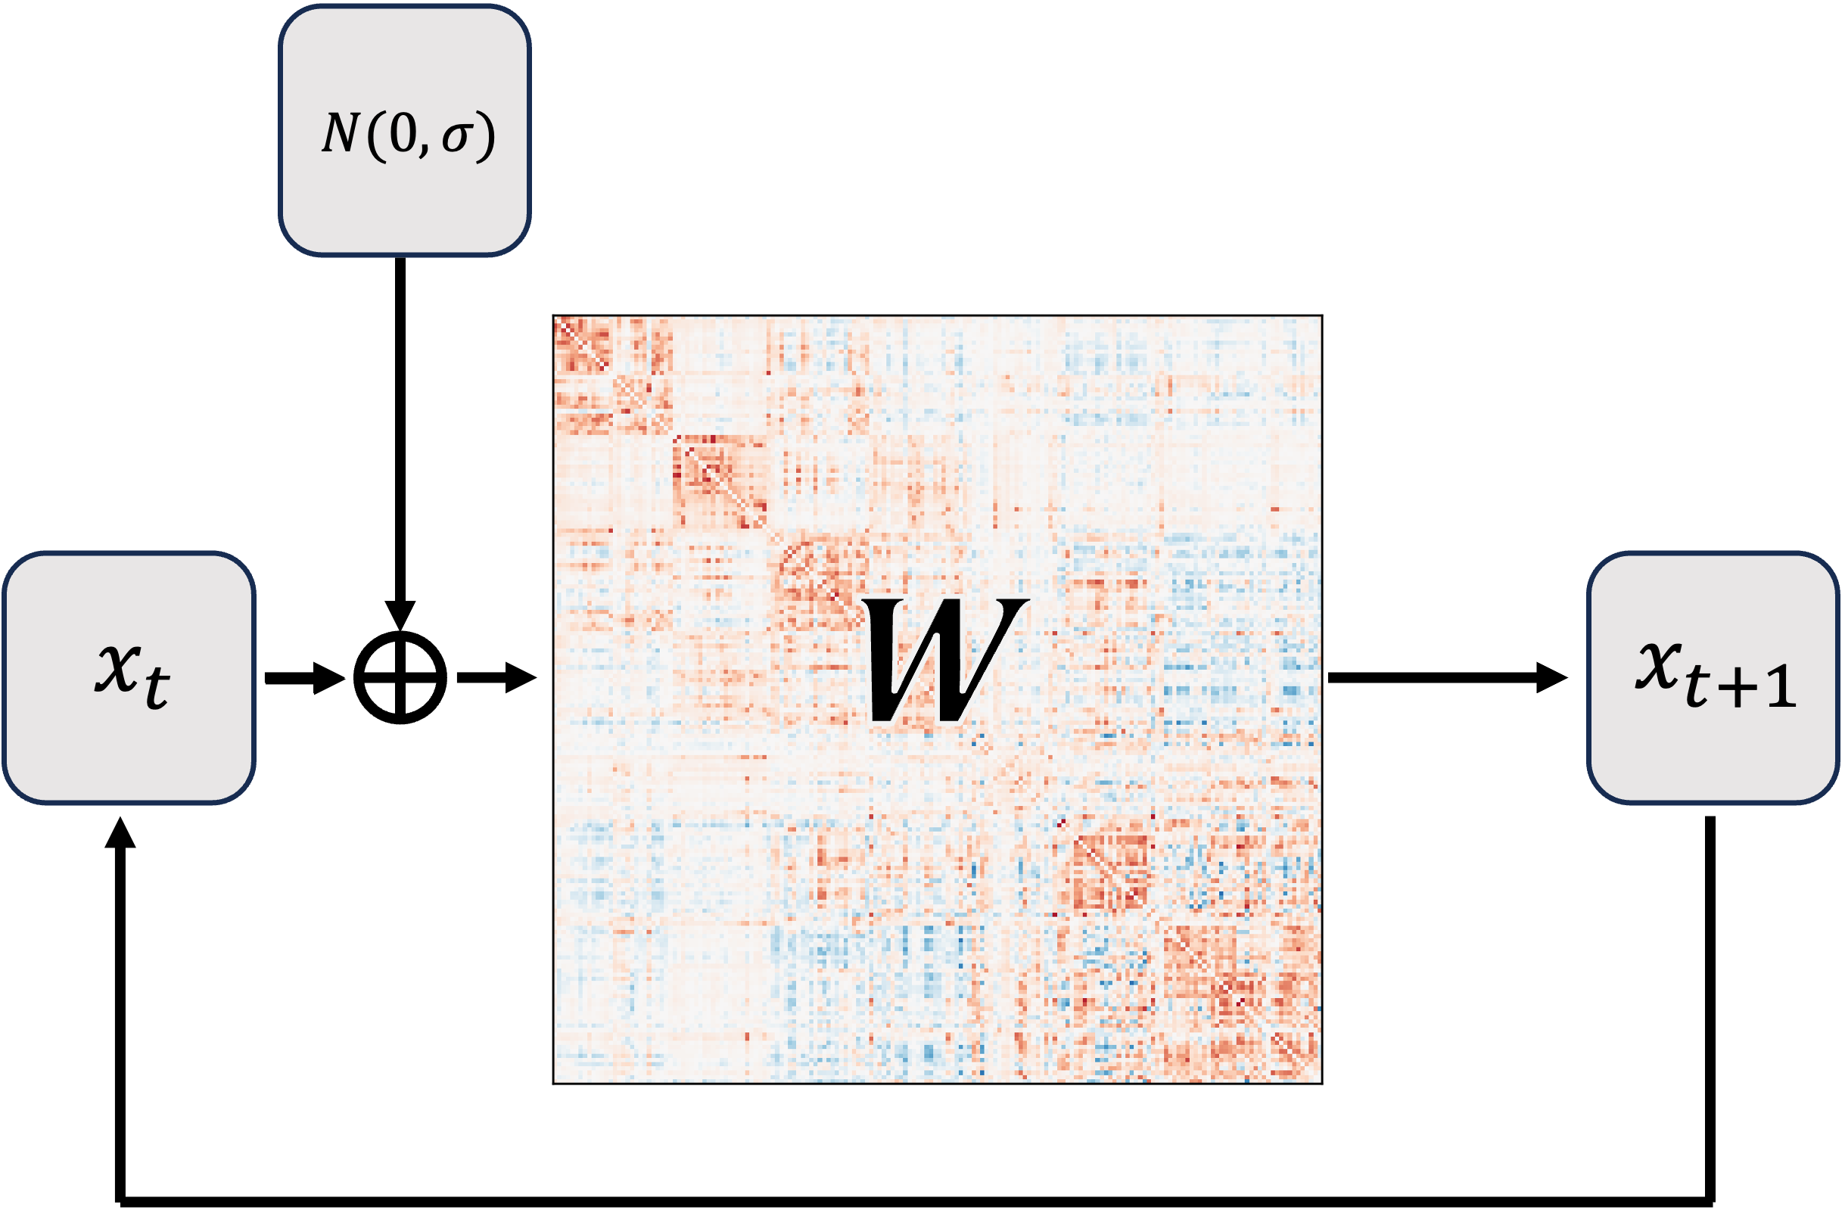
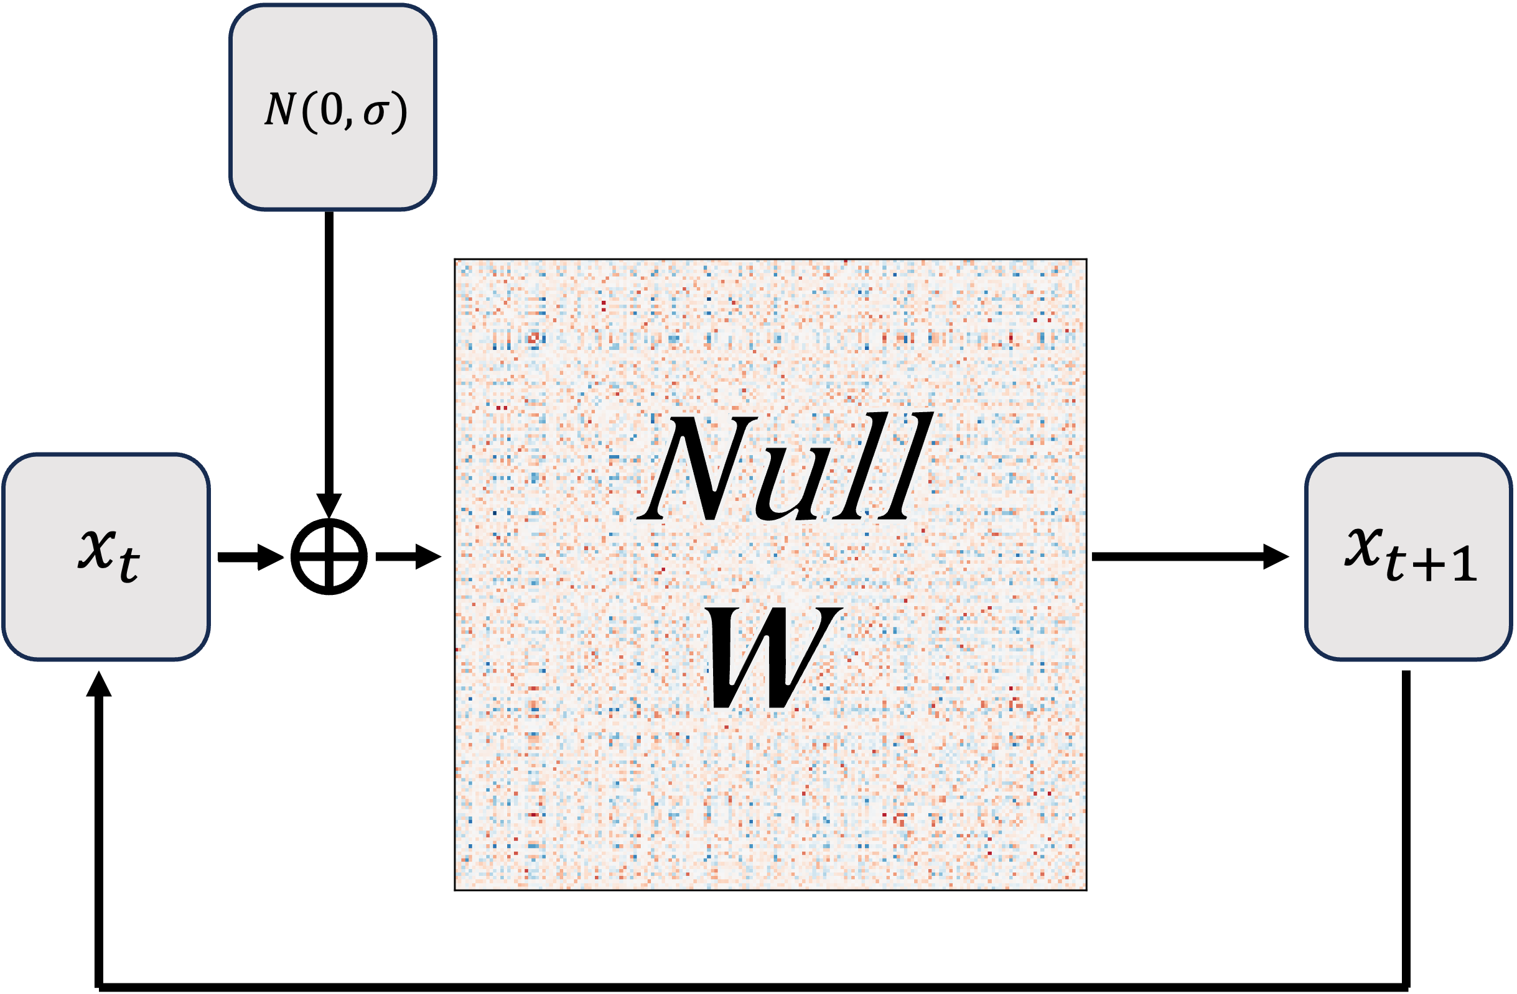
Model Validation by Generating BOLD
Use trained model to generate BOLD driven by noise
The causality model should be able to generate time series with similar property compared to brain dynamic.
The trained model should perform better than null model.

Slide 13
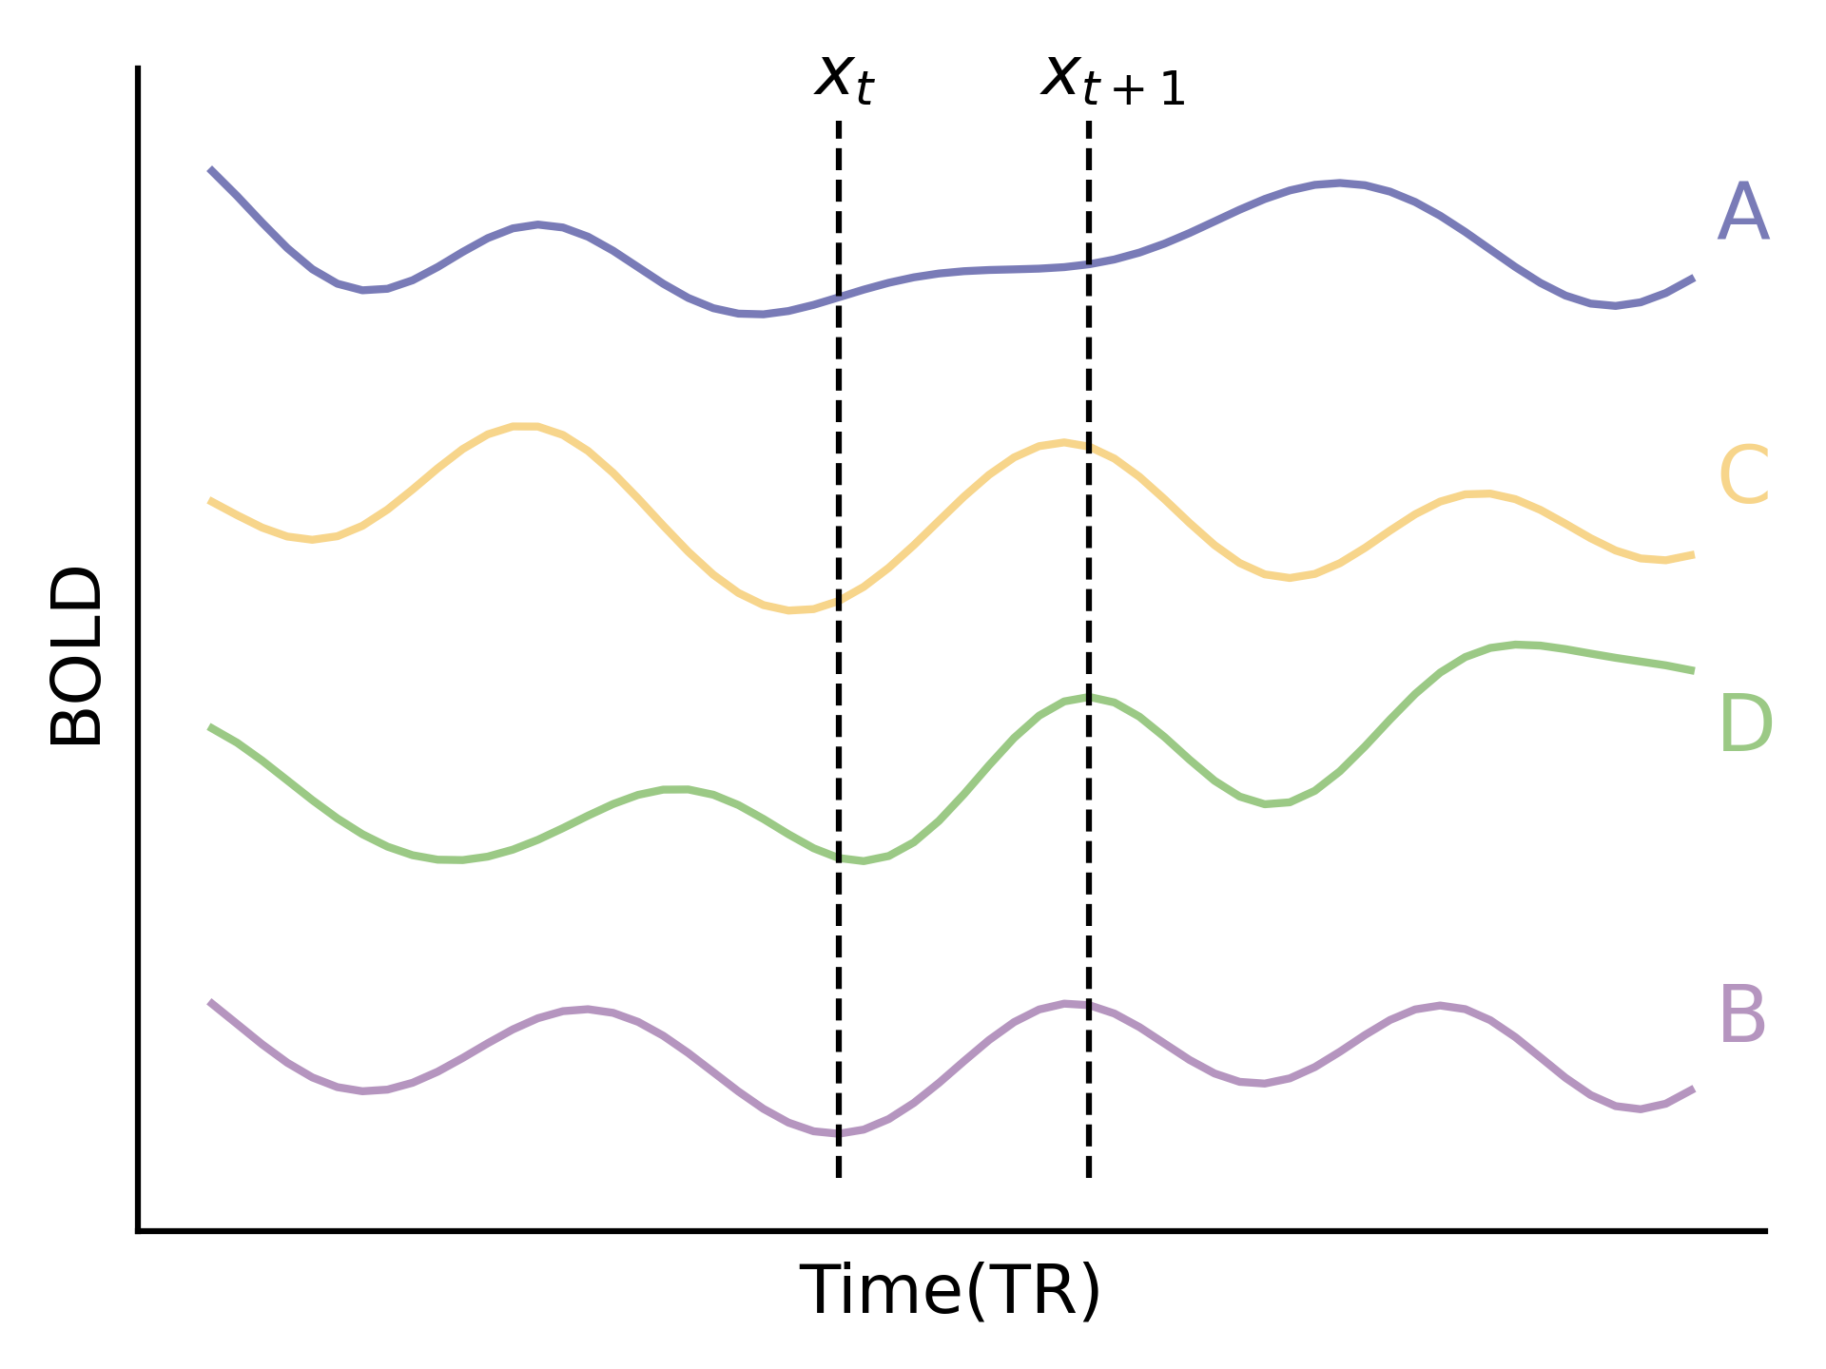
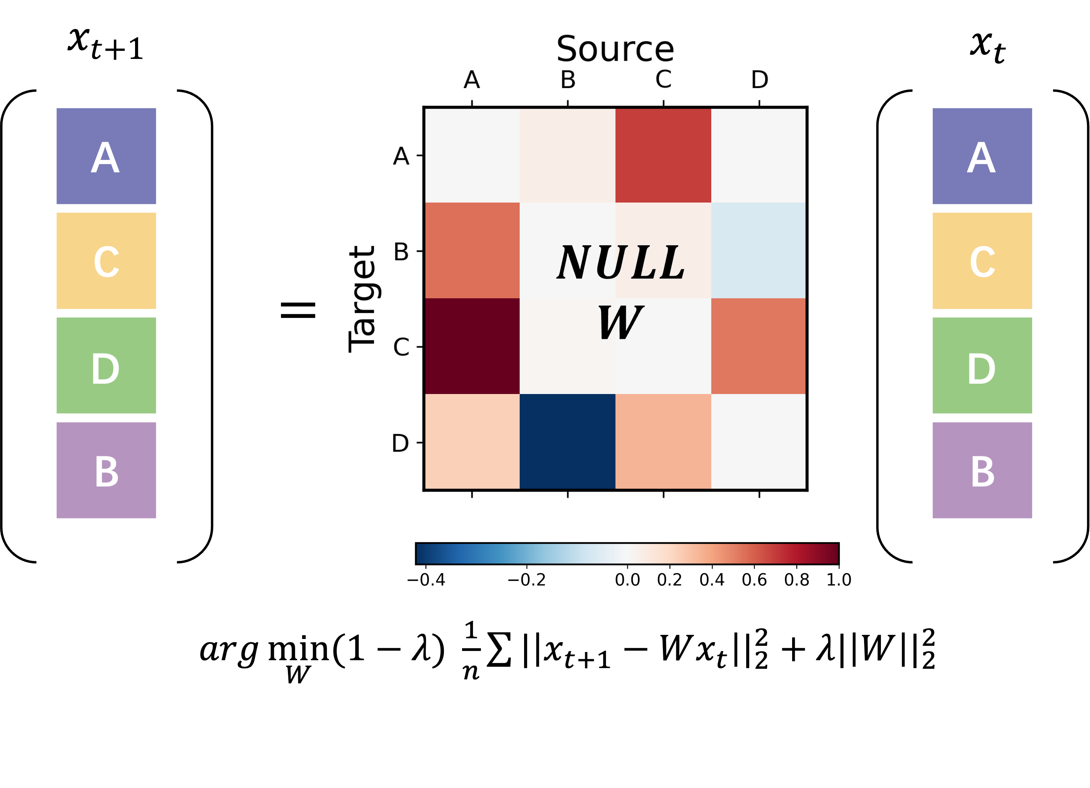
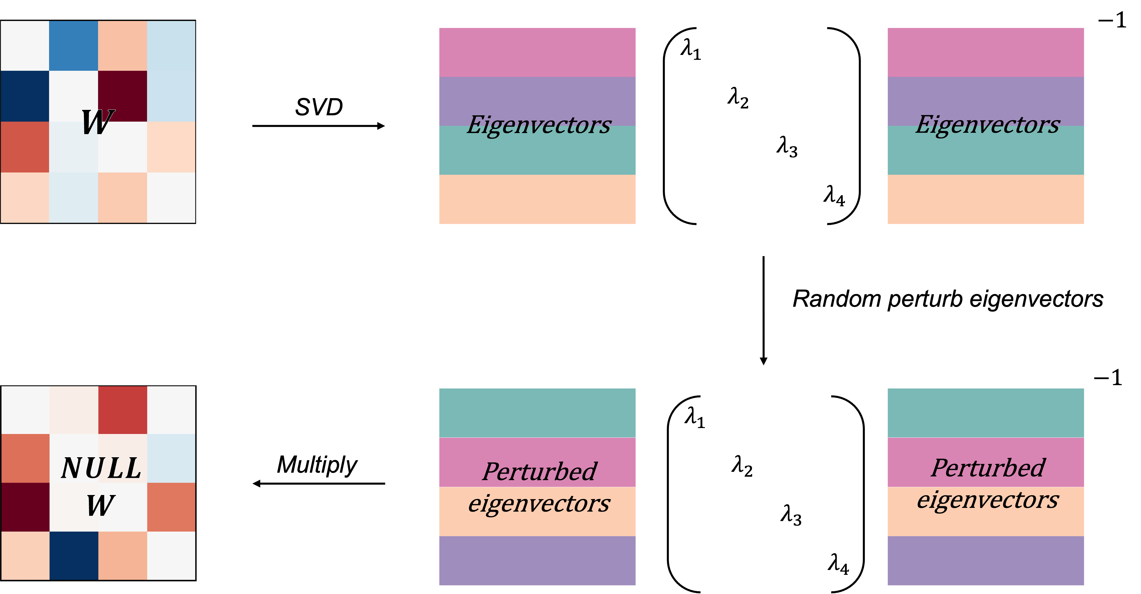
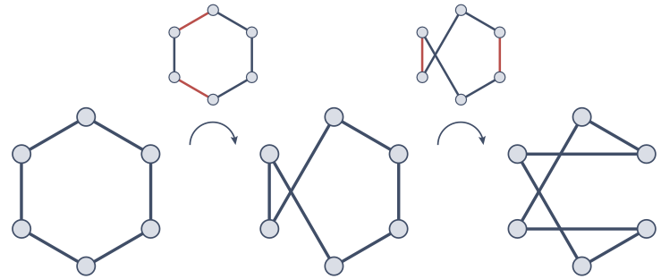
Model Validation by Generating BOLD
Random perturb regions
Null models are a baseline for comparing against observed data to identify significant effects.
Null models are generated by perturbing specific property in the original model.
Random perturb connections
Random perturb eigenvectors

Slide 14
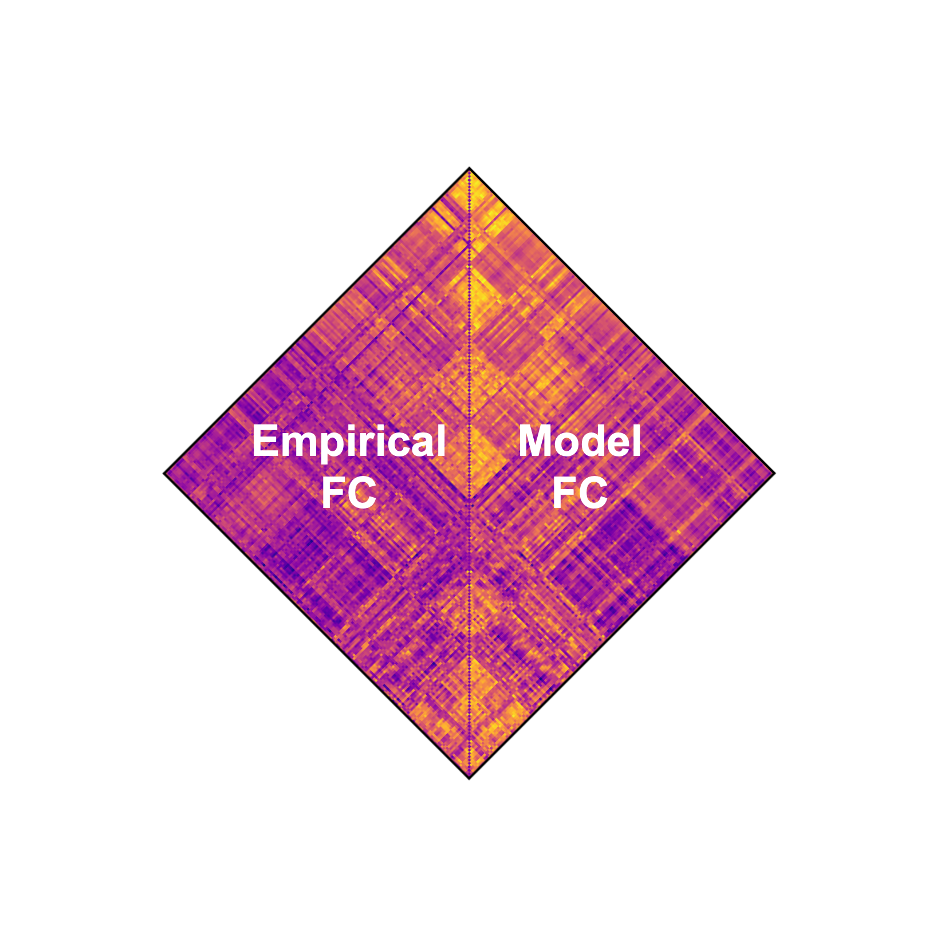
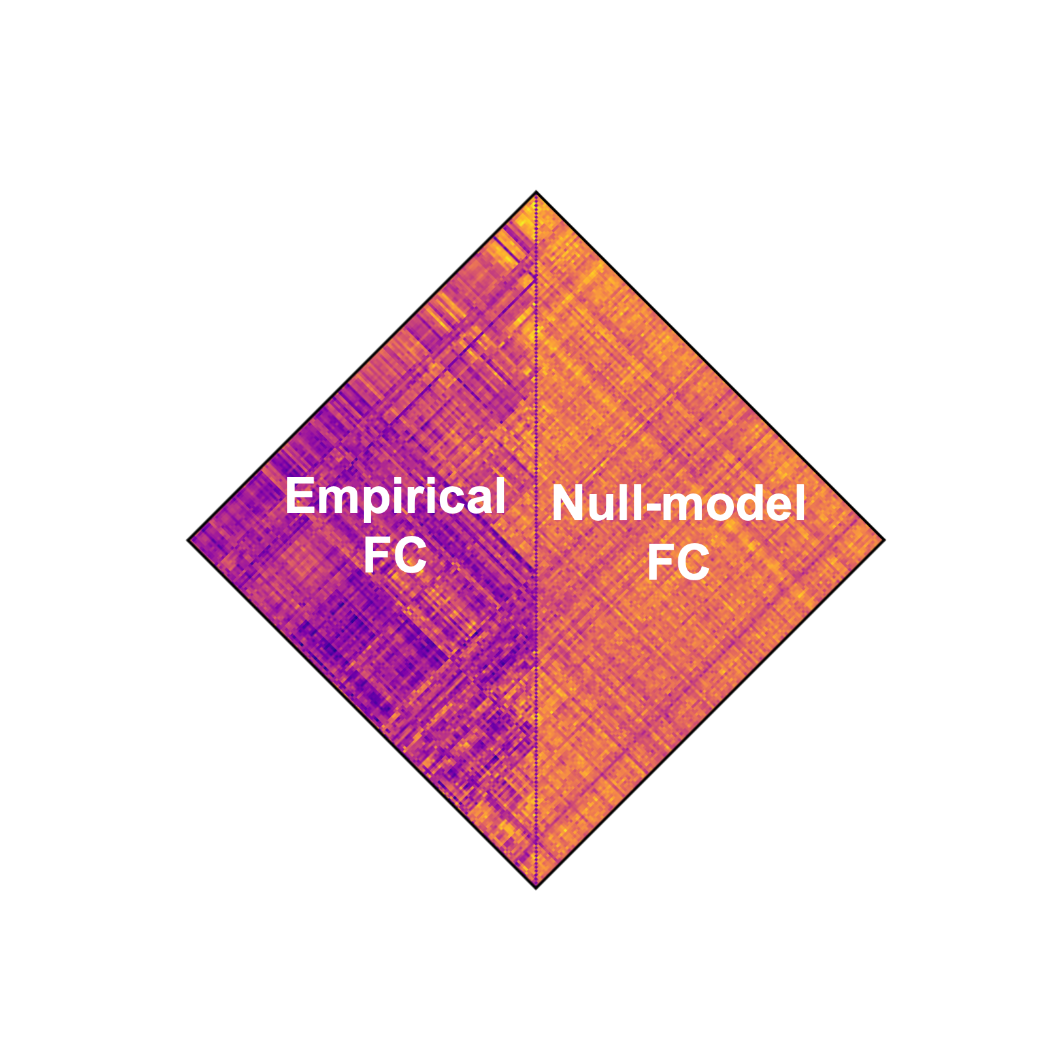
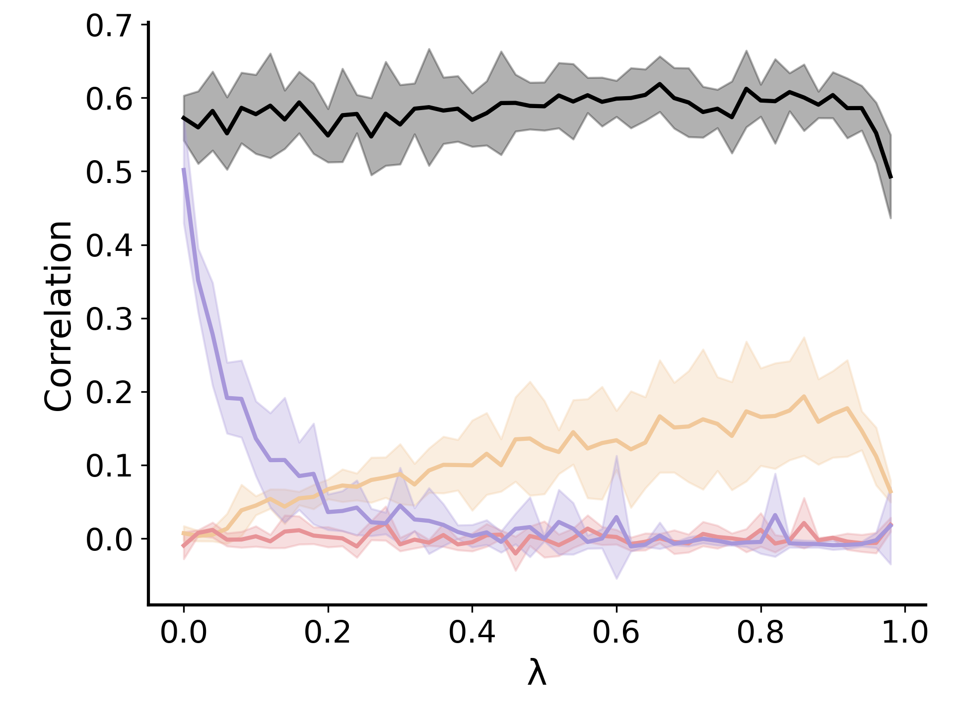
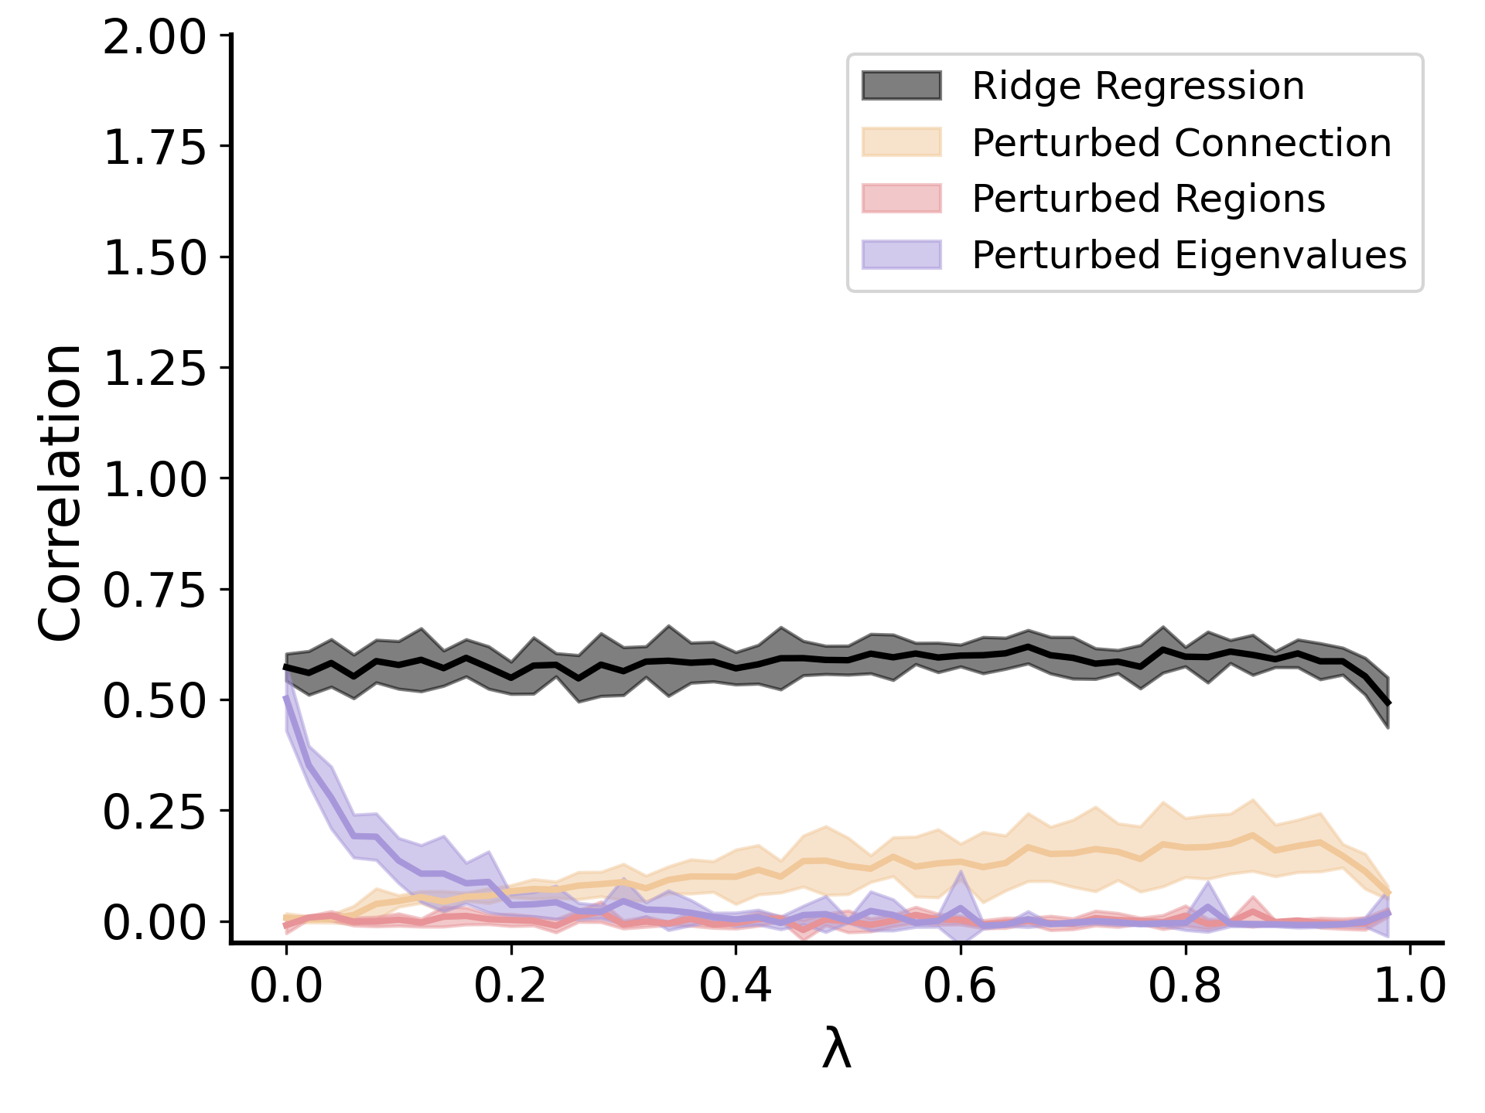
Model Validation by Generating BOLD
Compare the generated BOLD and real BOLD
Functional connectivity revealed by model generated BOLD shows high correlation with empirical data, while the one from null model not.
Regularized regression model successfully capture the brain dynamic.

Slide 15
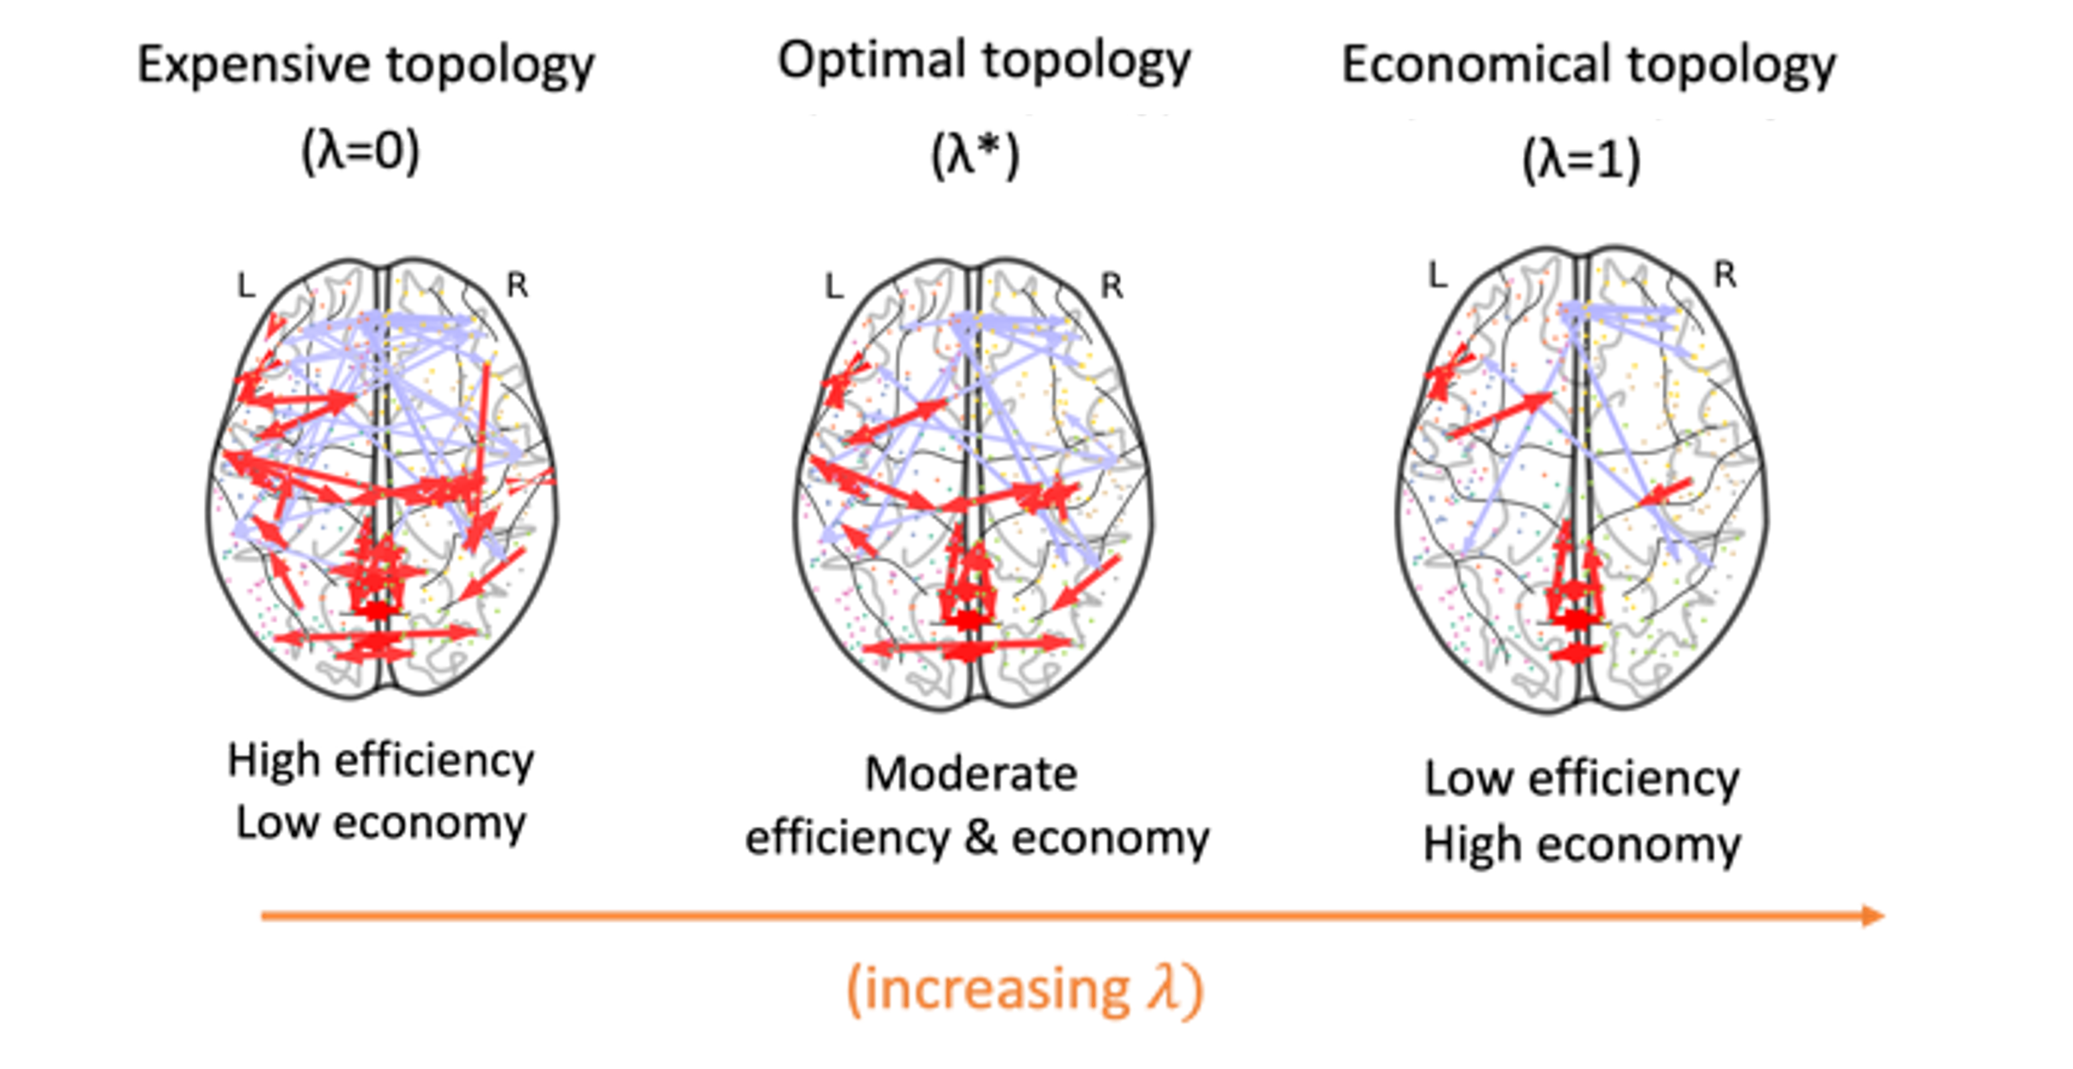
Efficiency-Economy Tradeoff
$arg\min_{W}{(1−λ) \frac{1}{n}\sum{{|\left|x_{t+1}−Wx_{t}\right||}_{2}^{2}}+λ{|\left|W\right||}_{2}^{2}}$
Term1: Recover dynamics
Term2: Constrain on wiring
Brain pursues a balance between and efficiency and economy. (Ed Bullmore, 2012)
The model can be trained to optimize for either accuracy of cognitive task or wiring cost.

Slide 16
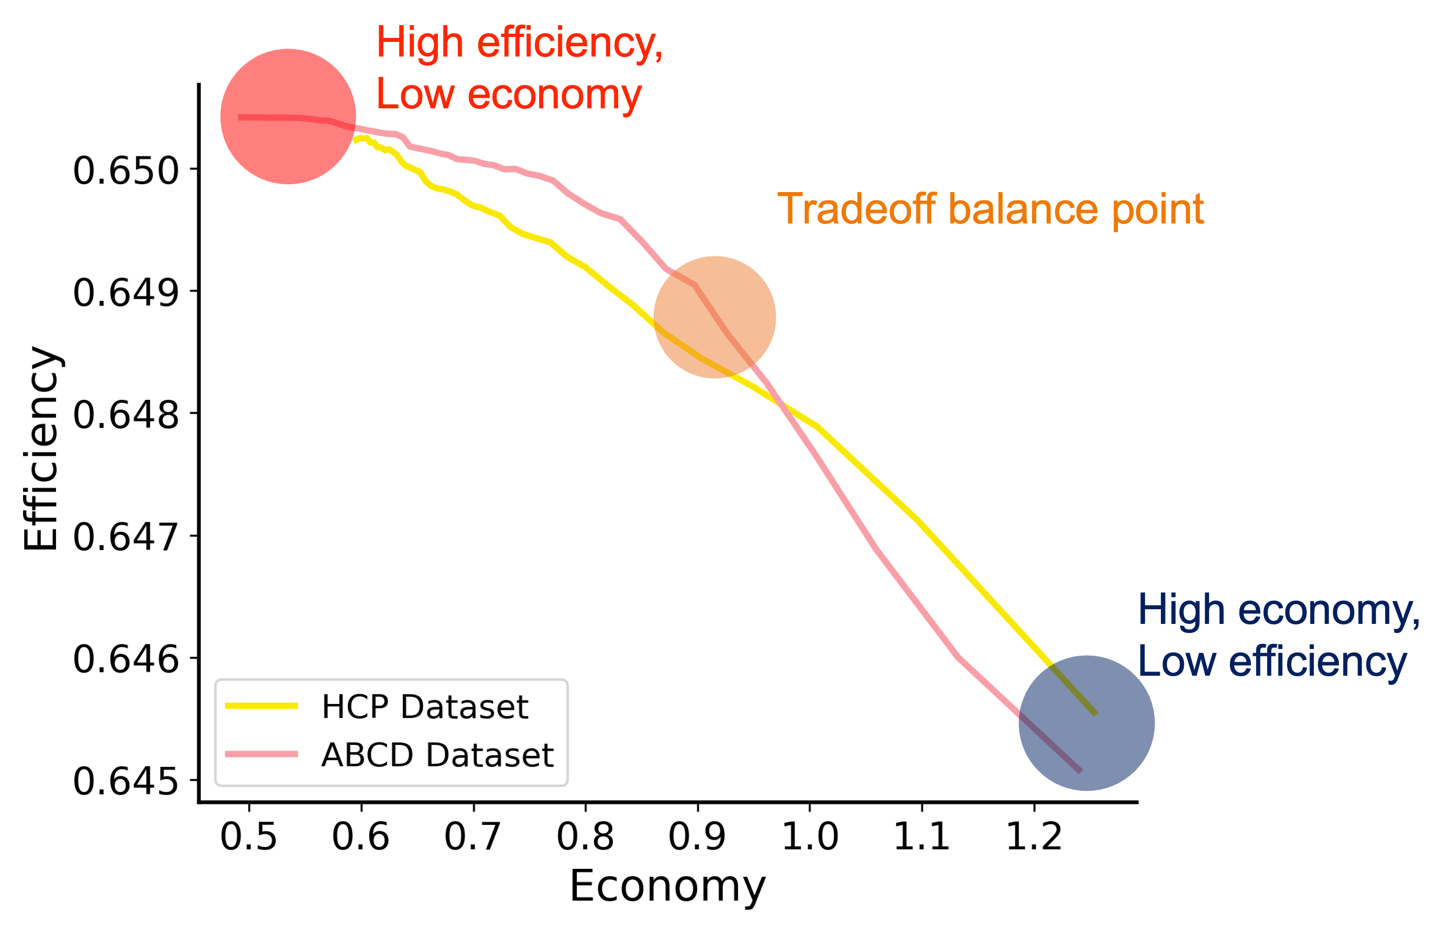
Efficiency-Economy Tradeoff
$arg\min_{W}{(1−λ) \frac{1}{n}\sum{{|\left|x_{t+1}−Wx_{t}\right||}_{2}^{2}}+λ{|\left|W\right||}_{2}^{2}}$
Term1: Recover dynamics
Term2: Constrain on wiring
Brain pursues a balance between and efficiency and economy. (Ed Bullmore, 2012)
The model can be trained to optimize for either accuracy of cognitive task or wiring cost.

Slide 17
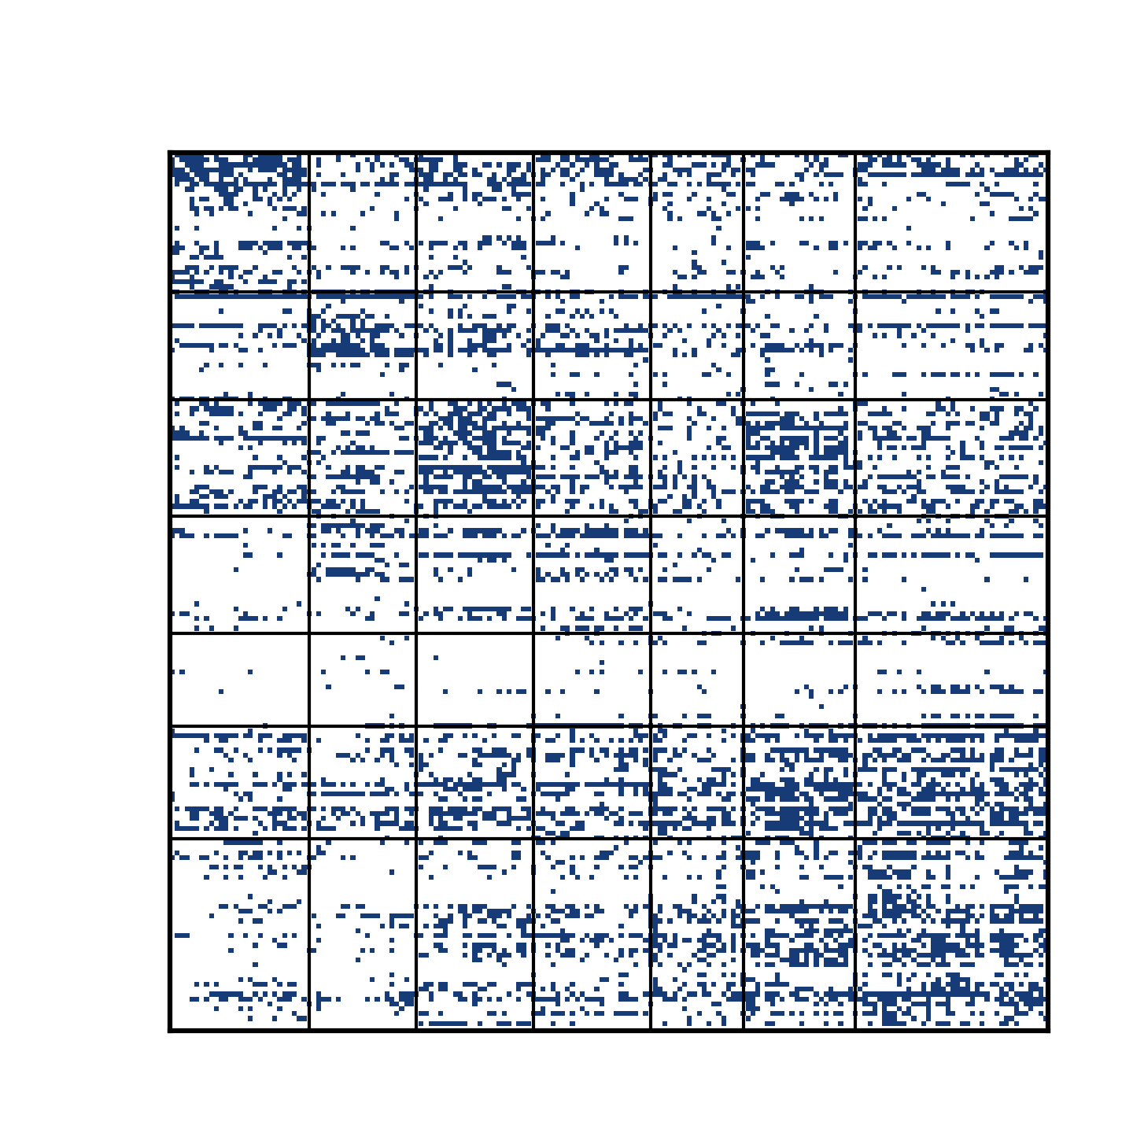
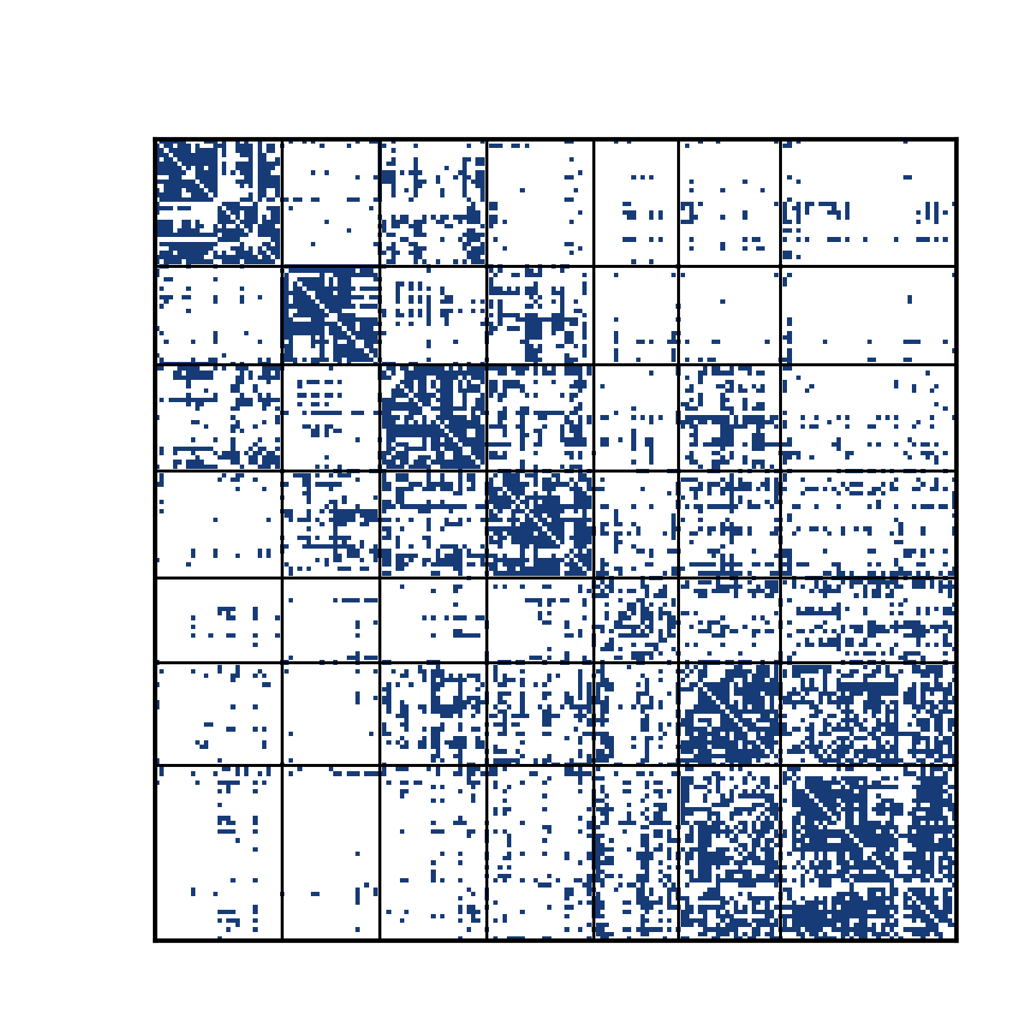
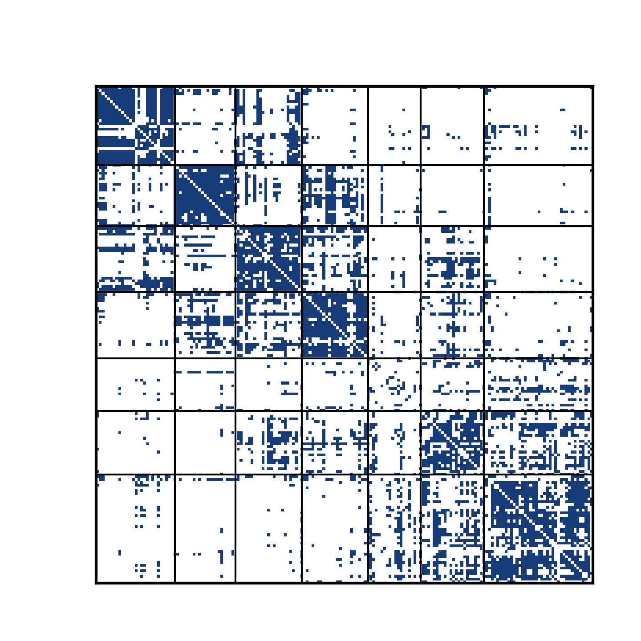
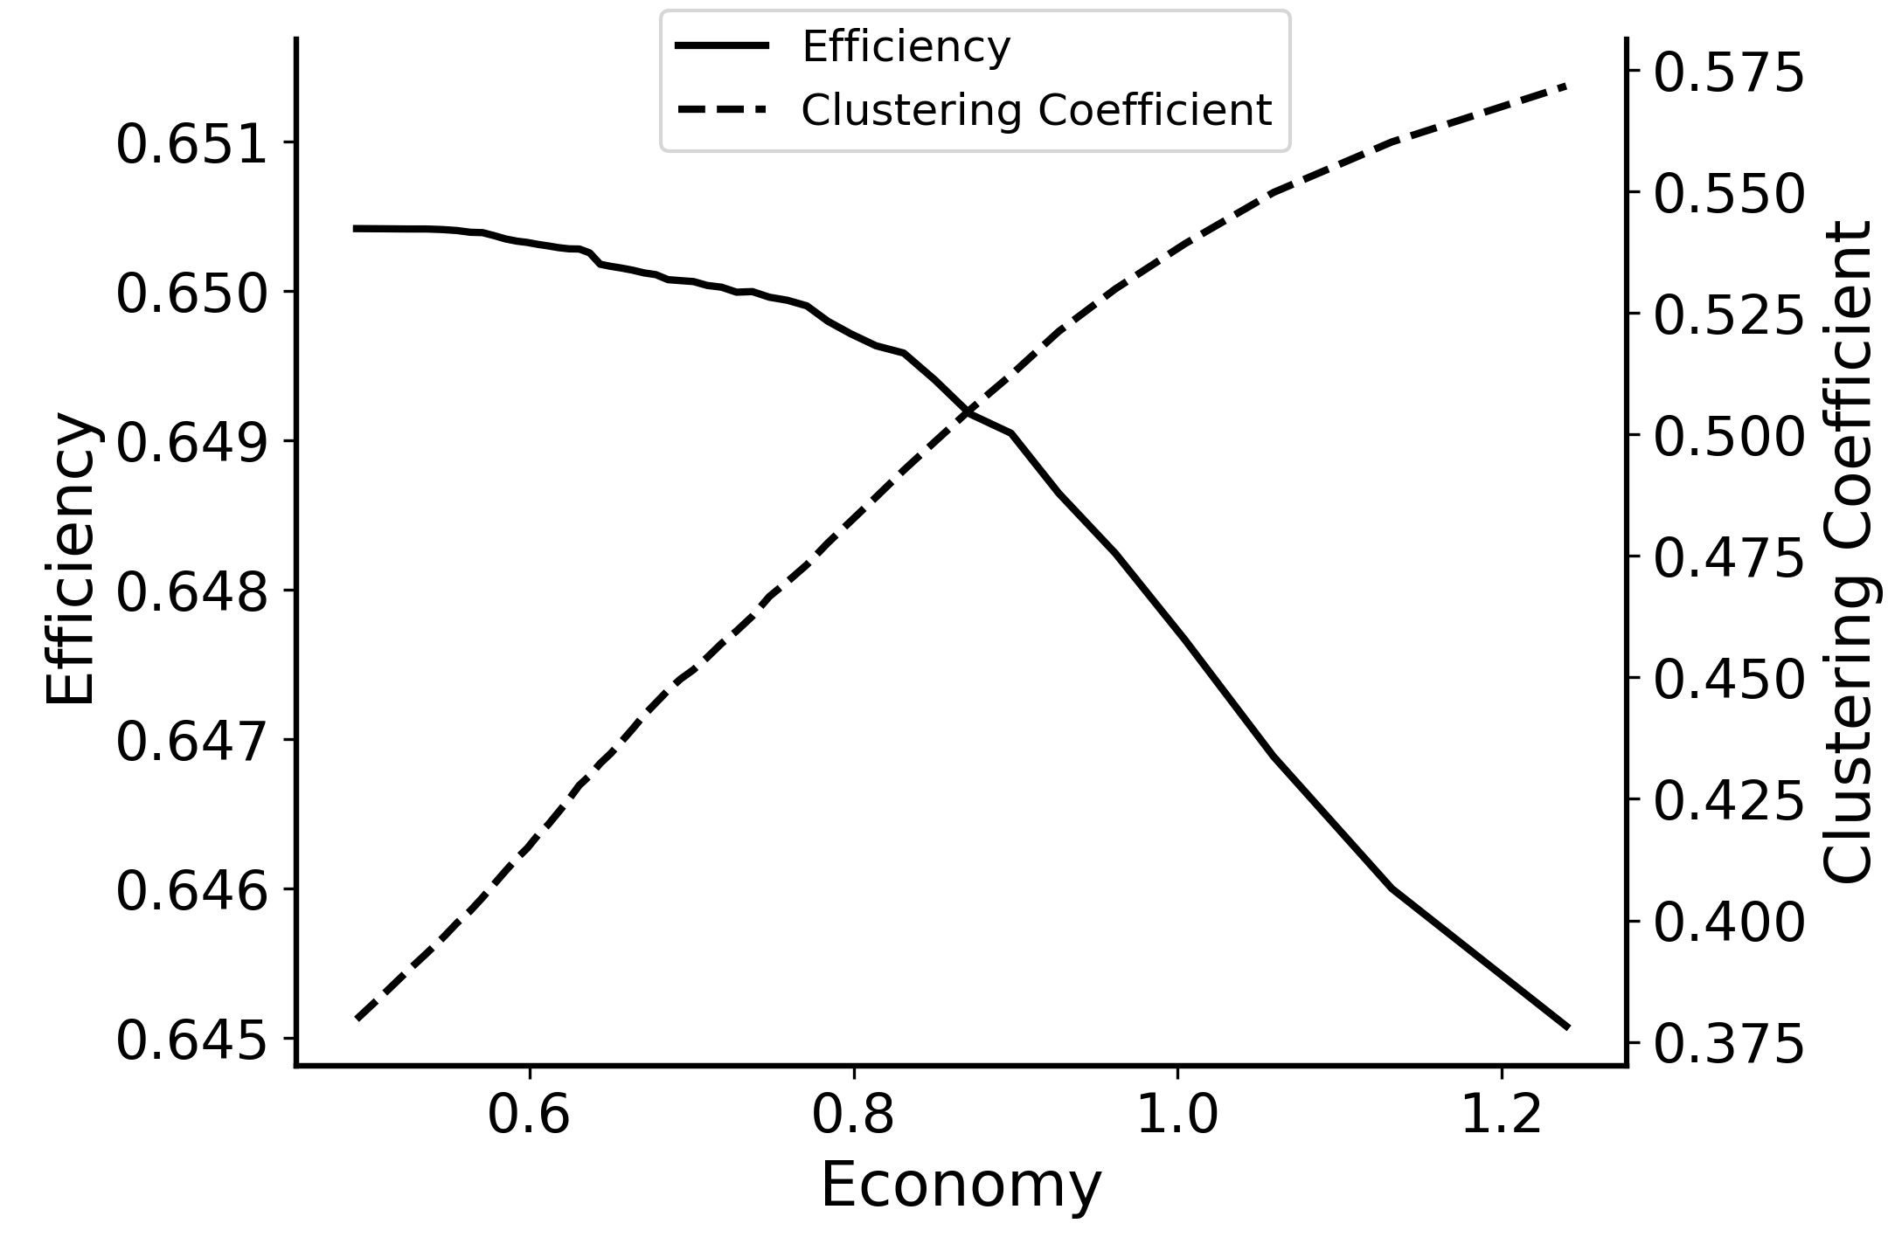
Efficiency-Economy Tradeoff in the brain
Modularity emerges with constrained energy
As the economy increases, the connectivity topology shows up modular structure.
3
2:
1:
3:
2
1
Increasing economy

Slide 18
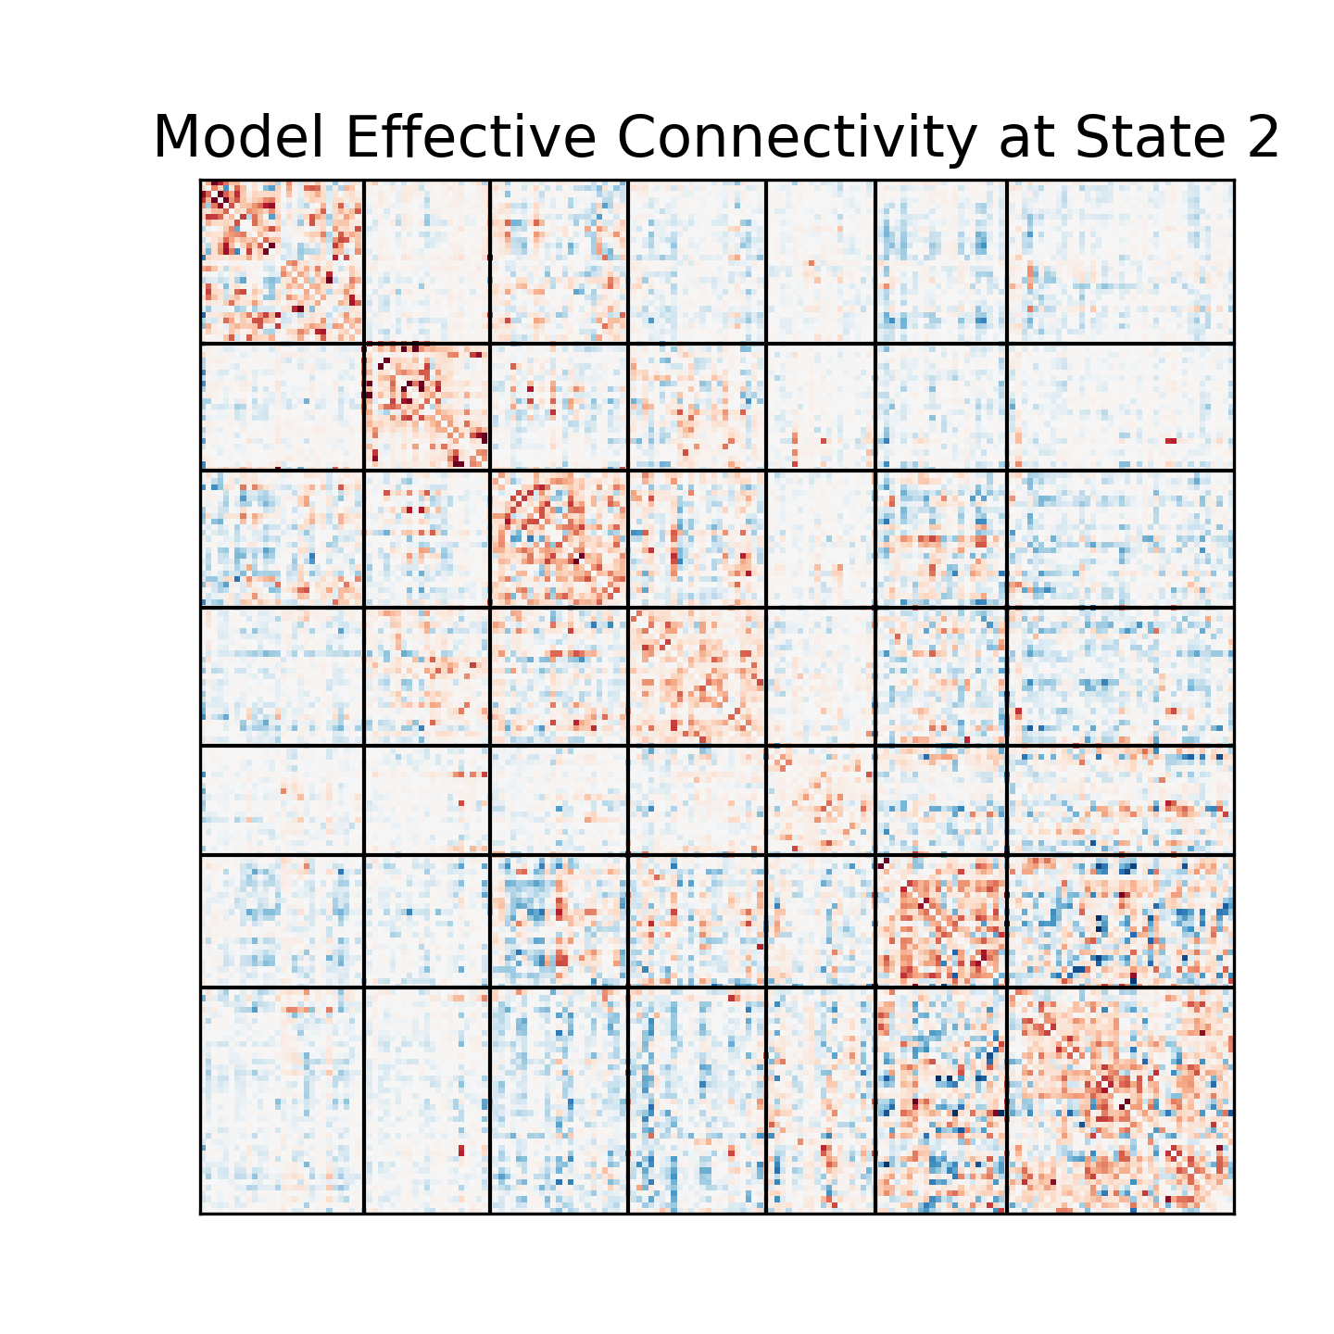
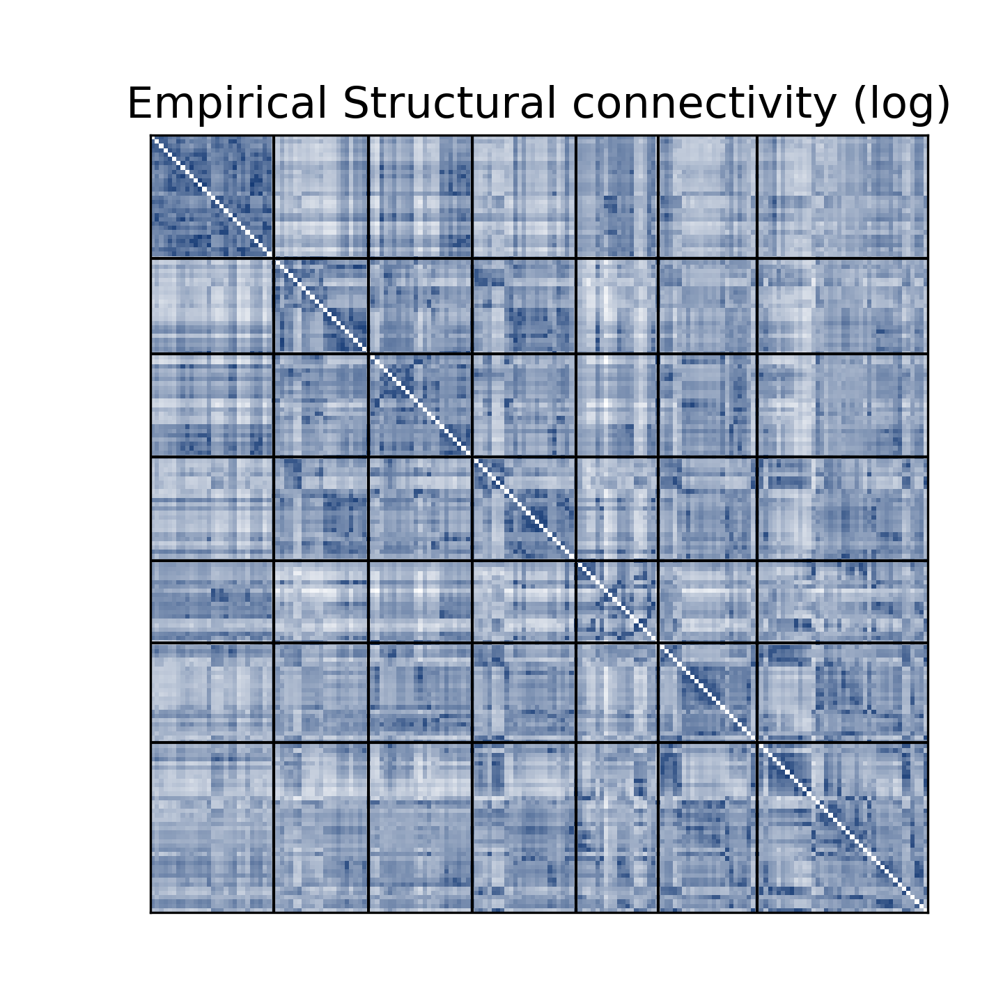
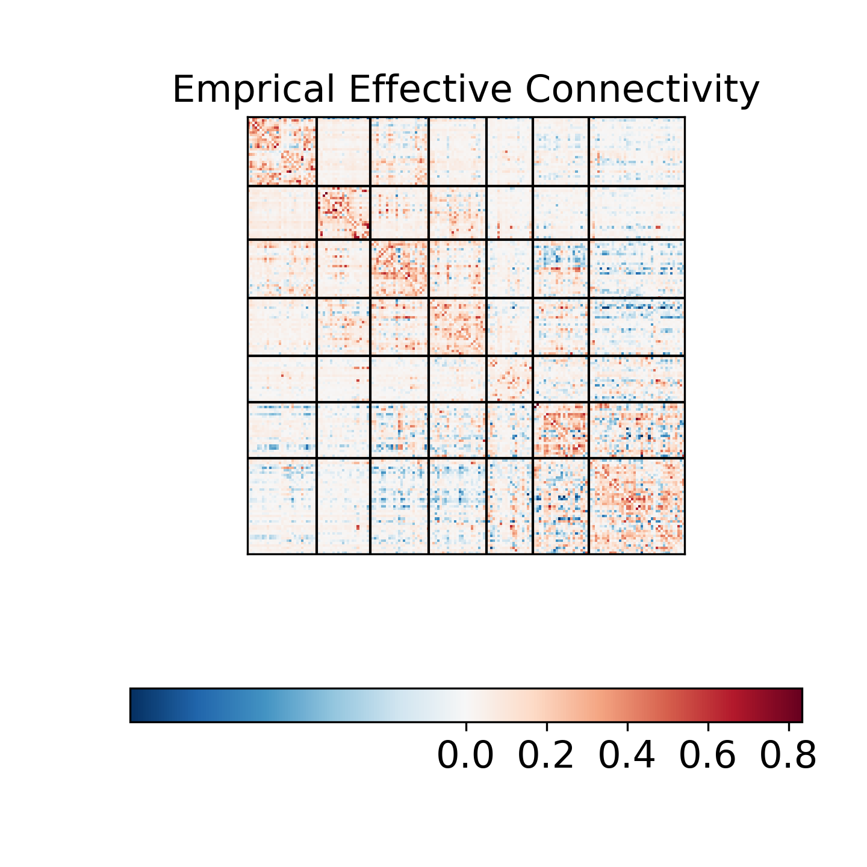
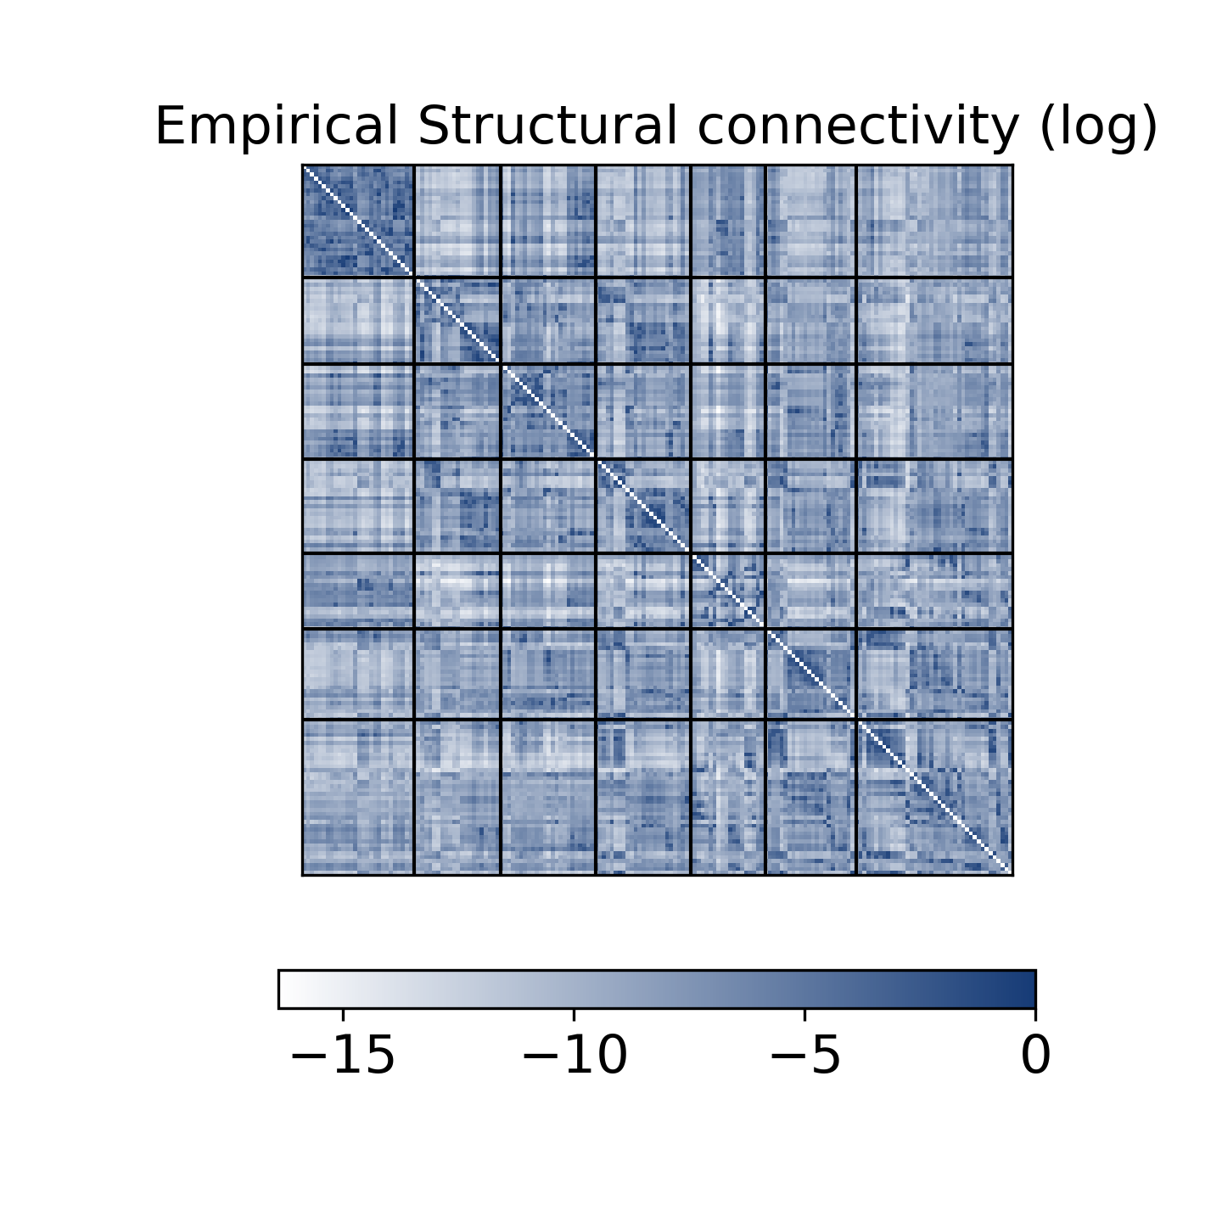
Efficiency-Economy Tradeoff in the brain
Topological structure resembles empirical connectivity
Network with moderate efficiency and economy shares similar topological structure with empirical EC and SC.
3
2
1

